Slide 1
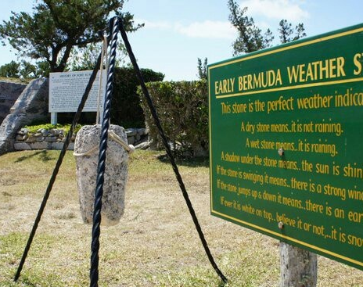
Oceanography
Saltus Grammar School
6.2 – Weather Forecasting

Slide 2
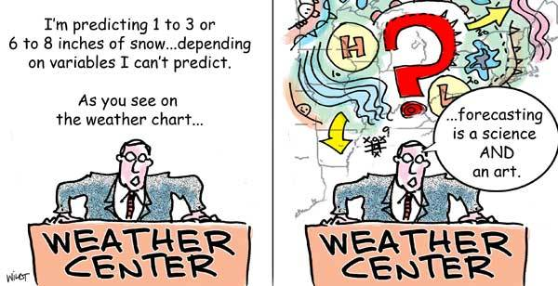
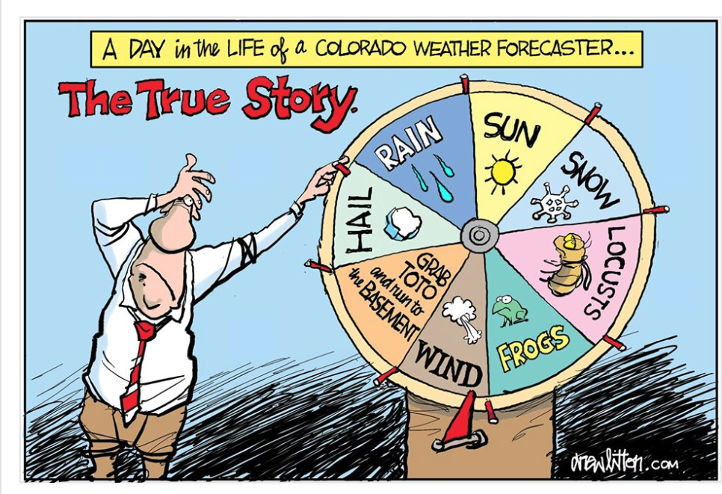
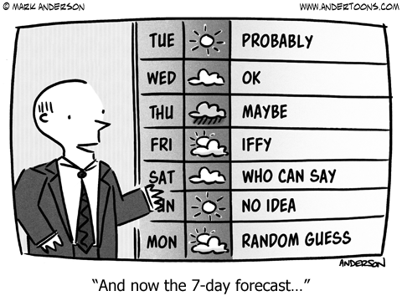
Why so many jokes?

Slide 3
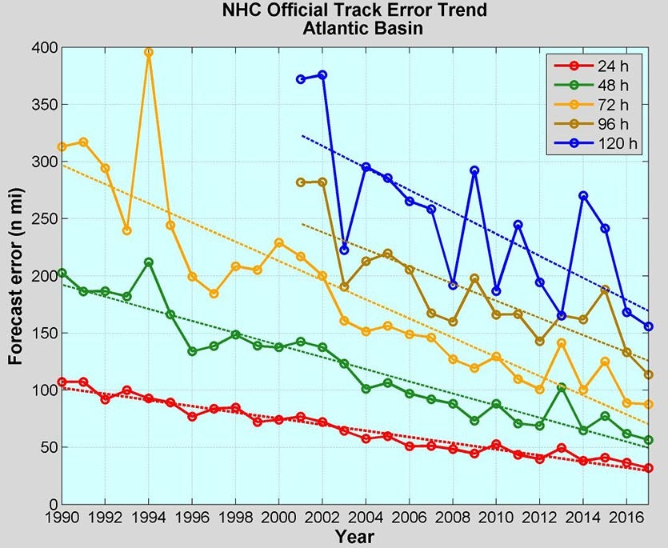
Reality
Weather forecasting has dramatically improved over the years, especially recently.
Weather forecasting is vastly more reliable than “economic forecasting” – yet is still ridiculed, why?
Hard to quantify (which variable?) and everyone gets upset if they get wet.

Slide 4
How to forecast the weather
Persistence
Tomorrow’s weather will be the same as today’s weather.
This works for many countries - as long as the weather is stable!

Slide 5
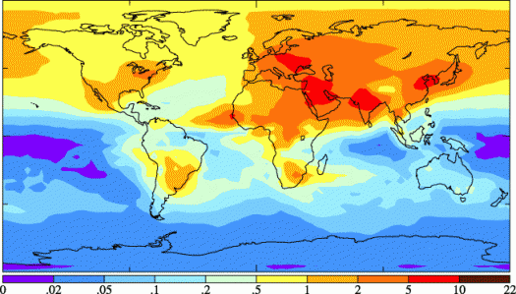
How to forecast the weather
Climatology
This is based on recorded weather over a number of years.
It is July, so it will be hot and sunny with a light SW breeze. Maybe a chance of showers in the afternoon

Slide 6
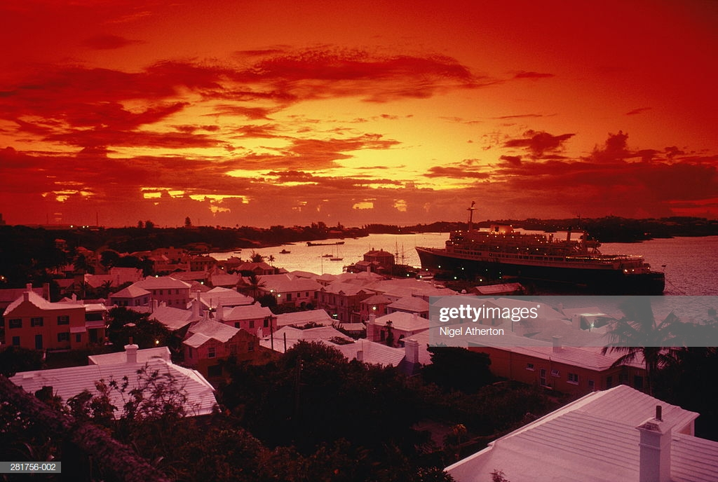
How to forecast the weather
Observations
Based on previous observations of weather patterns.
Examples:
Old sayings – red sky at night, sailors delight
Pressure drops more than 3 mbars in 3 hours → storm is coming
Big swells off south shore and dark clouds building → storm/hurricane
Shark oil does something funny → hurricane

Slide 7
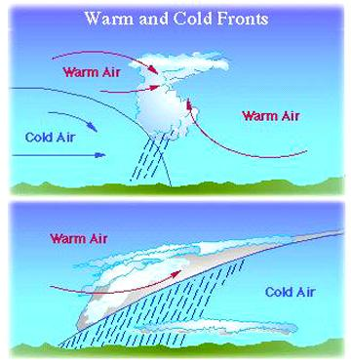
How to forecast the weather
Air masses
Based on the model of fronts and anticyclones
Northerly winds bring cool temperatures and low humidity, Southerly winds bring warm temperatures, some clouds and high humidity.
Boundaries and changes bring wet, windy weather.

Slide 8
How to forecast the weather
Computer models
Based on worldwide observations that are fed into sophisticated computer simulations (models) of the atmosphere (and ocean). Essentially Minecraft on a much finer scale. Problems are:
Limited computer power leads to limited resolution.
Not all the physics is either understood or able to be simulated.
REALLY BIG COMPUTERS required!

Slide 9
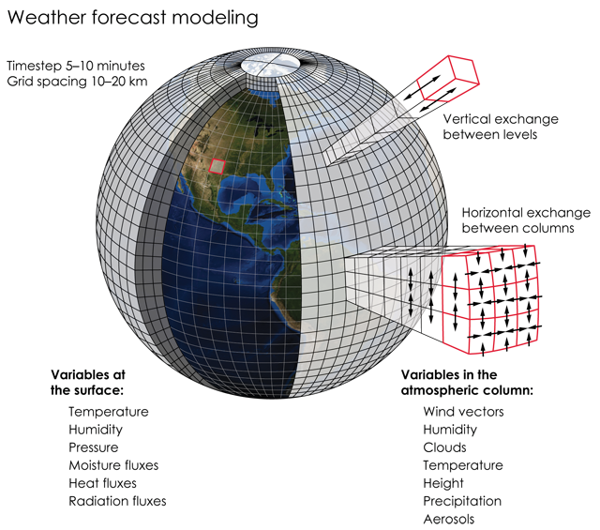
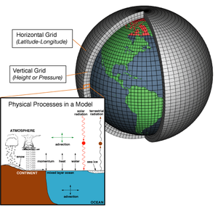

Slide 10
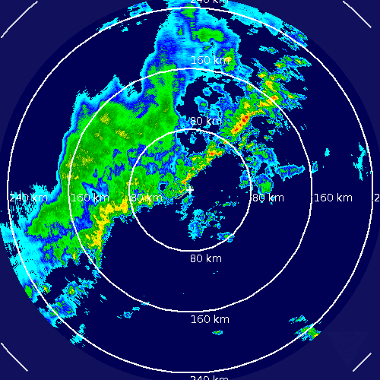
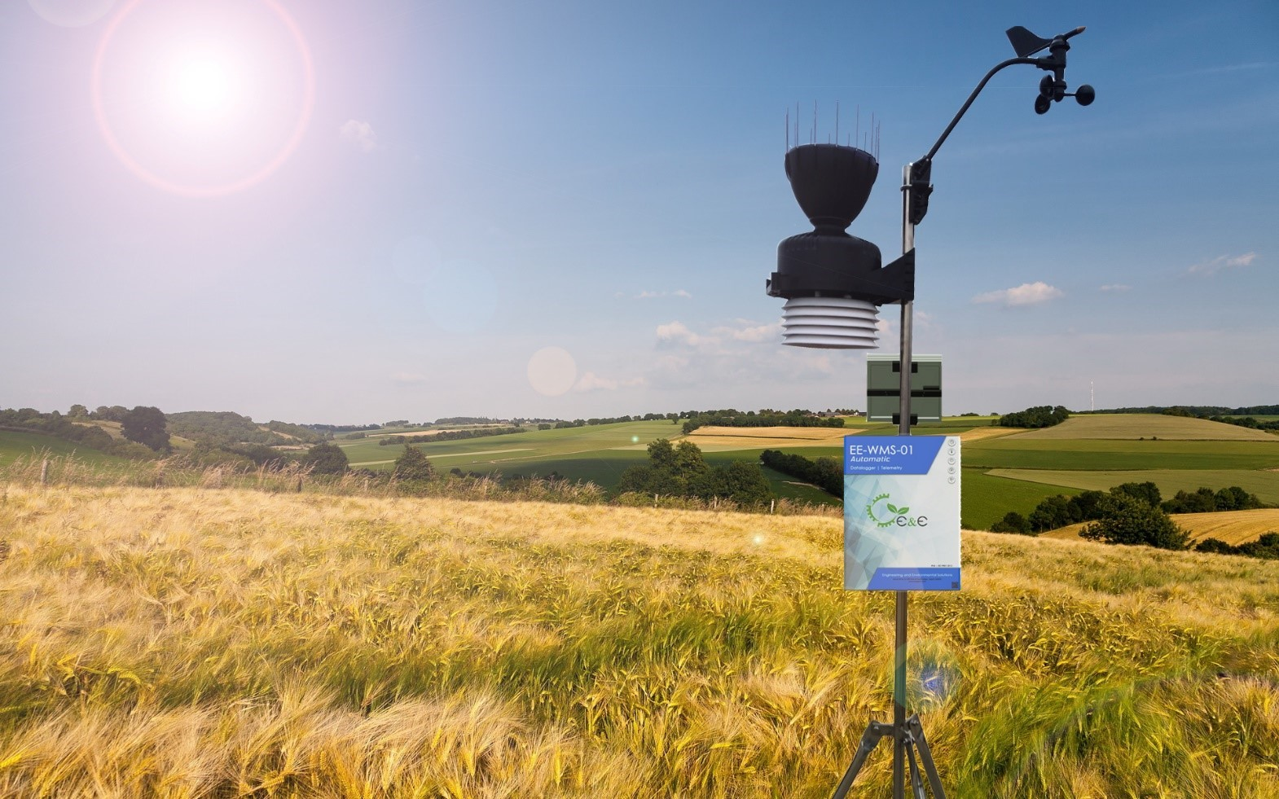
Observations that are fed into the models
Ocean temperature
Winds from Satellites
Clouds from satellites
Ground based observations
Ocean weather buoys
Ship weather observations
Aircraft weather observations

Slide 11
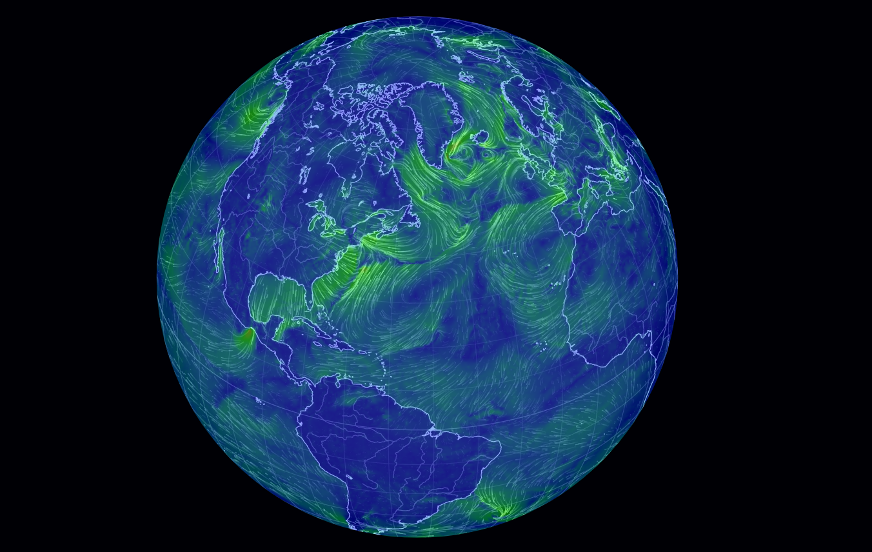
A massive computer game!
Literally: virtual reality…..

Slide 12
Major Weather Centres that produce models
Met Office (UK)
NOAA (US)
ECMWF (EU)
MeteoFrance (France)
plus, most major countries
All are coordinated via the World Meteorological Organisation

Slide 13
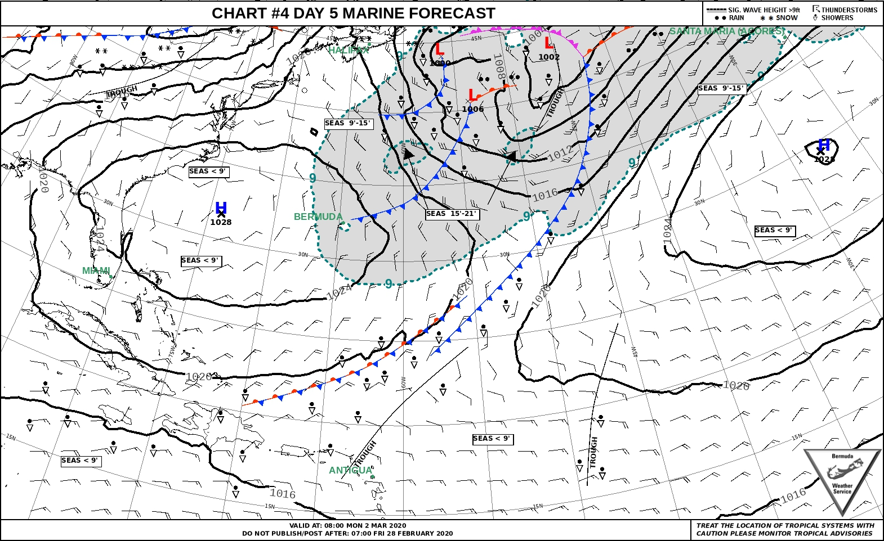
How to Present?
Presentation is a BIG DEAL. Early forecasts were crude. Charts were hard to understand. Widespread availability of smart phones and the increased speed of the internet have led to many companies repackaging the forecasts.
For example: Most weather agencies sell their model data and NOAA is obliged to give it for free.
Some companies tweak the model data for certain areas. I.e. they use the NOAA or Met Office model to feed into their smaller model of a specific location (e.g. Hawaii) that is run at a higher resolution.
Marketing is key!

Slide 14
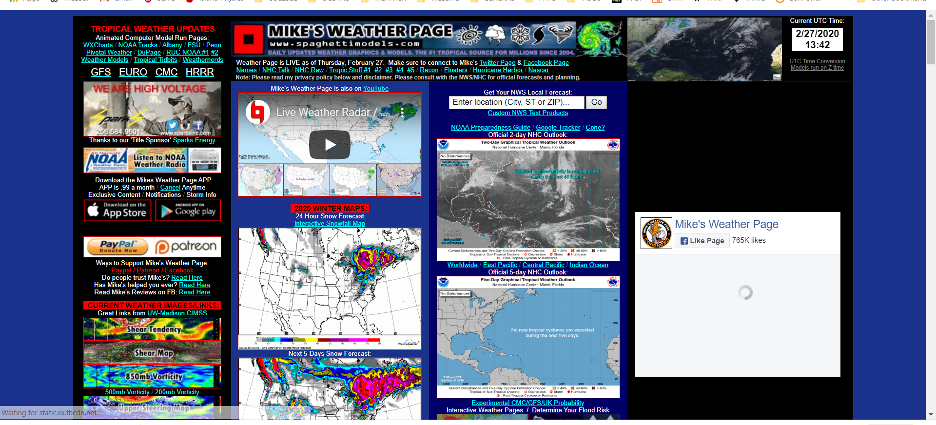
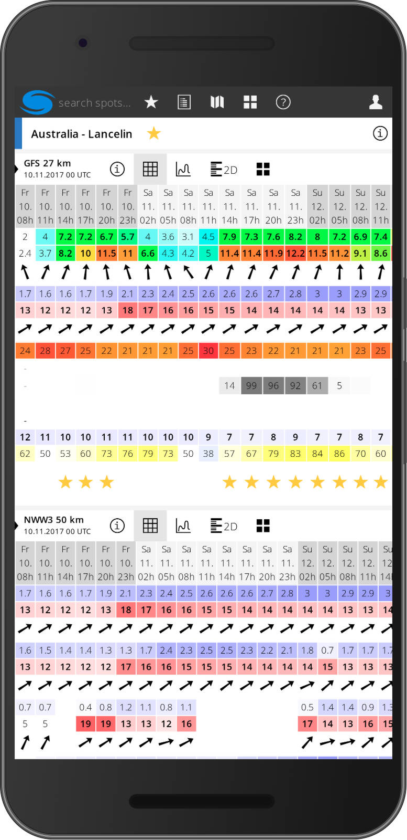
Some Private Companies
Weather.com
Weather Underground
Apple Weather
AccuWeather
Windguru
Windy
Spaghettimodels.com (crude!)

