Slide 1
Salinity
Oceanography

Slide 2
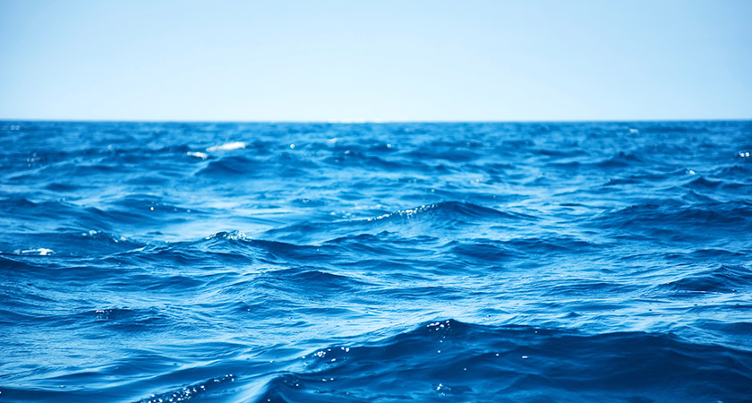

Slide 3
WET

Slide 4
WET
SALTY

Slide 5
WET
SALTY
COLD/WARM

Slide 6
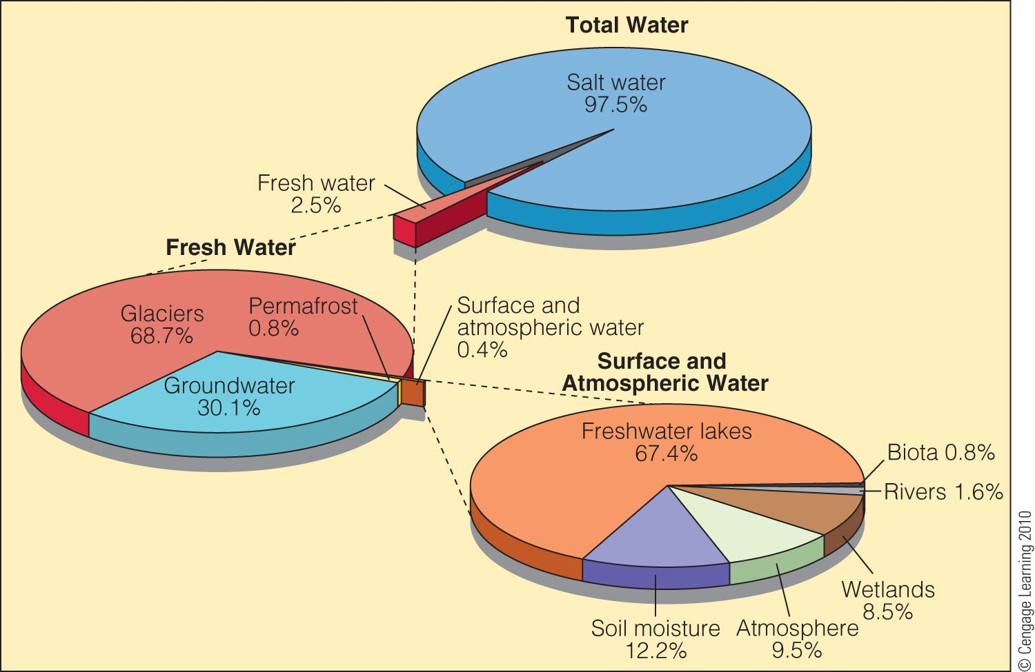
Water, water everywhere?

Slide 7
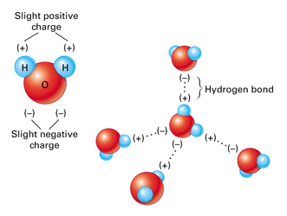
Water Molecule

Slide 8
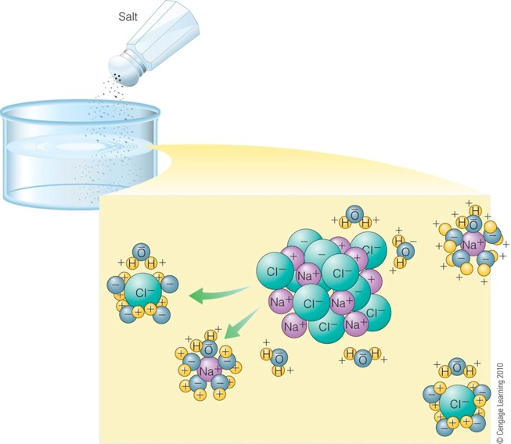
Dissolving NaCl

Slide 9
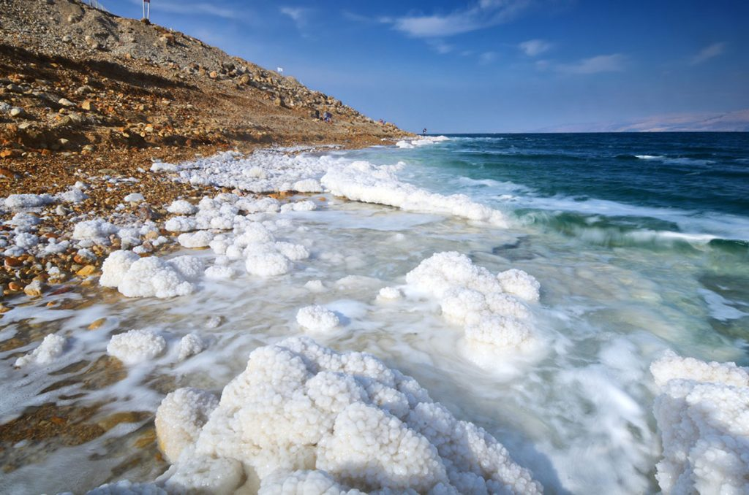
When the water evaporates

Slide 11
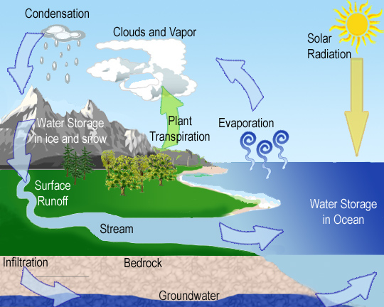
Where does it come from? Water Cycle
Salts are dissolved in the water as it runs to the sea

Slide 12
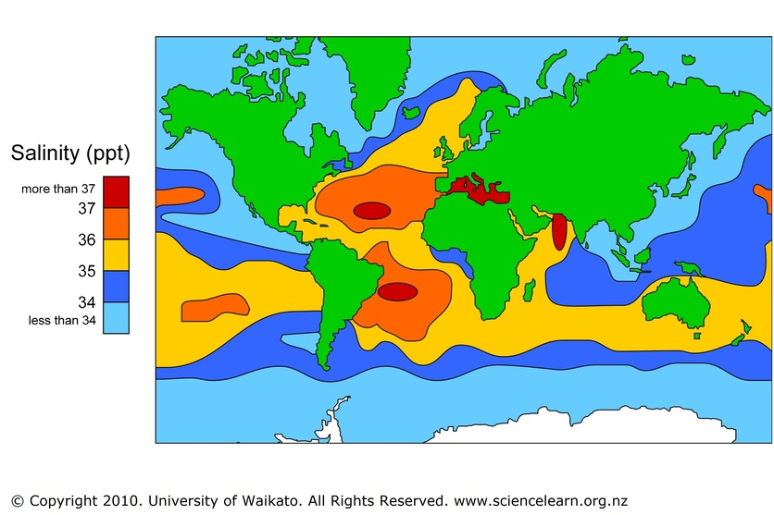
Sea Surface Salinity

Slide 13
LAB – Making Saltwater Samples
Salinity (PSU) | Salt (g) | Water (g = ml) | Density (g/ml)
0 | 0 | 1000
5 | 5 | 995
10 | 10 | 990
20 | 20 | 980
25 | 25 | 975
30 | 30 | 970
35 | 35 | 965
40 | 40 | 960
50 | 50 | 950
60 | 60 | 940
$$density=\frac{mass}{volume}$$

