Slide 1
Max speed of sail boats?
Thrust v friction

Slide 2
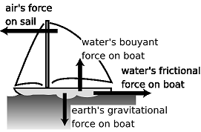
Forces on a boat
Key to making a boat go faster is to increase the thrust and reduce the drag

Slide 3
Displacement Hull Speed
Maximum Hull Speed
Maximum hull speed (in knots) = 1.34 x the square root of the waterline length (in feet)
- See more at: http://www.sailboat-cruising.com/hullspeed.html#sthash.3J8chSfn.dpuf

Slide 4
Fitted Dinghy
Upthrust = weight

Slide 5
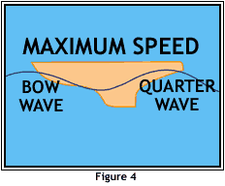
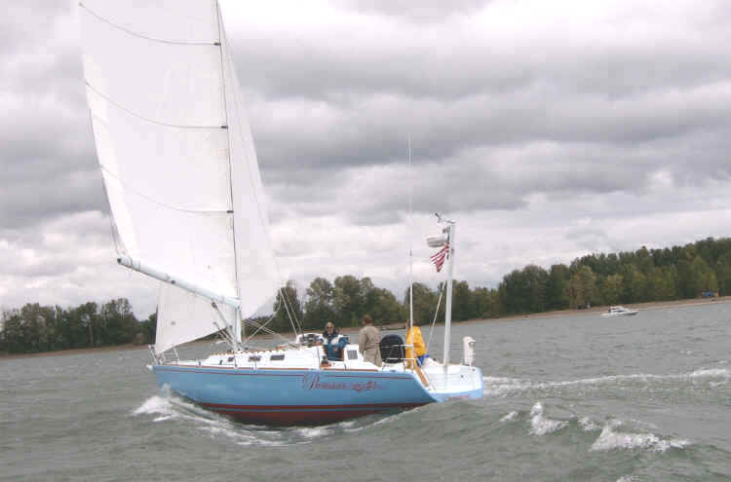
Bow wave and wake

Slide 6
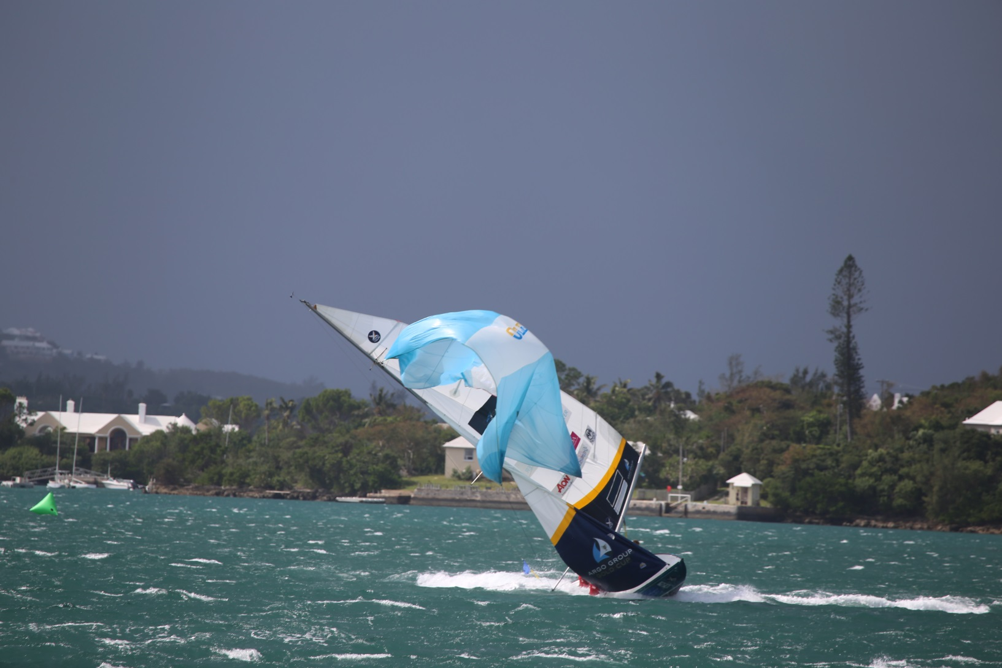
Rock and roll

Slide 7
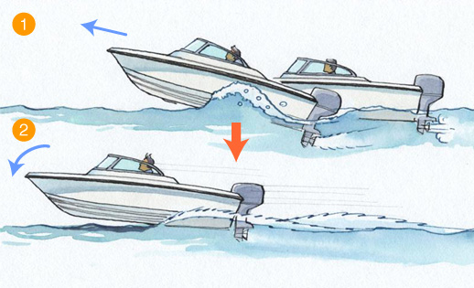
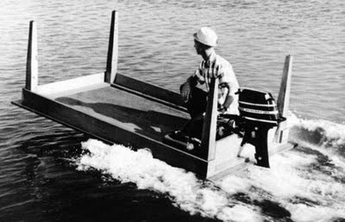
Planing
Upthrust + lift = weight

Slide 8
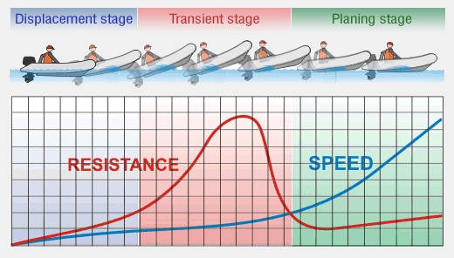
Thrust constant – drag isn’t!

Slide 9
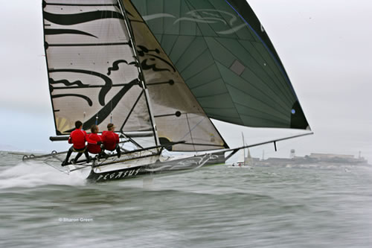
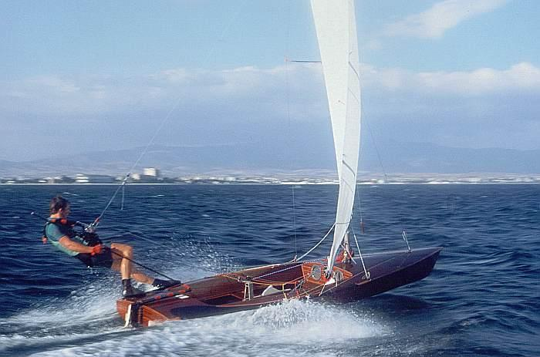
Sailboats can plane too!

Slide 10
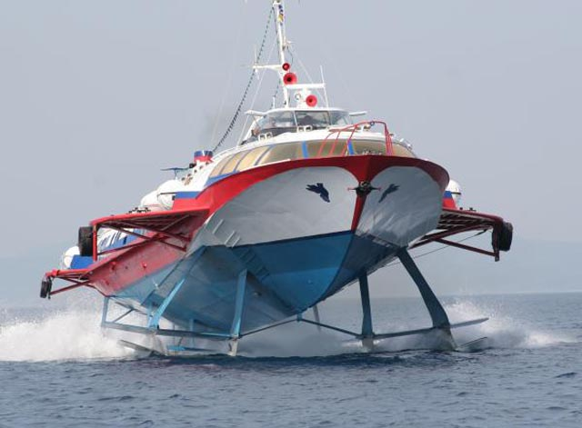
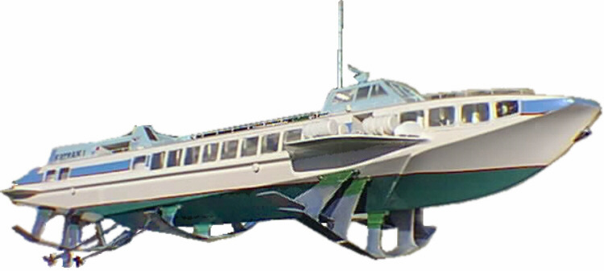
Hydrofoils

Slide 11
This boat has no hull!
Lift from foils = weight

Slide 12
AC45 - Hydrofoiling

