Slide 1
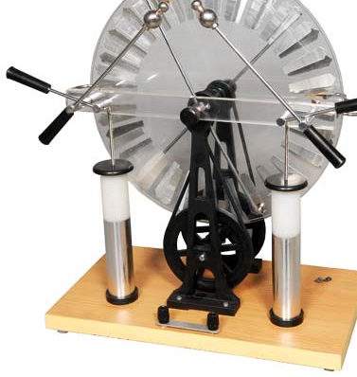
Generating Electricity
Year 9 Science
…or how to spin a generator…

Slide 2
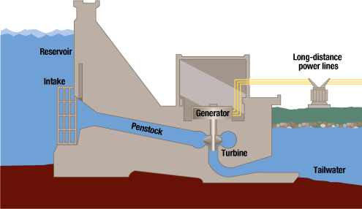
Direct – hydroelectric power

Slide 3
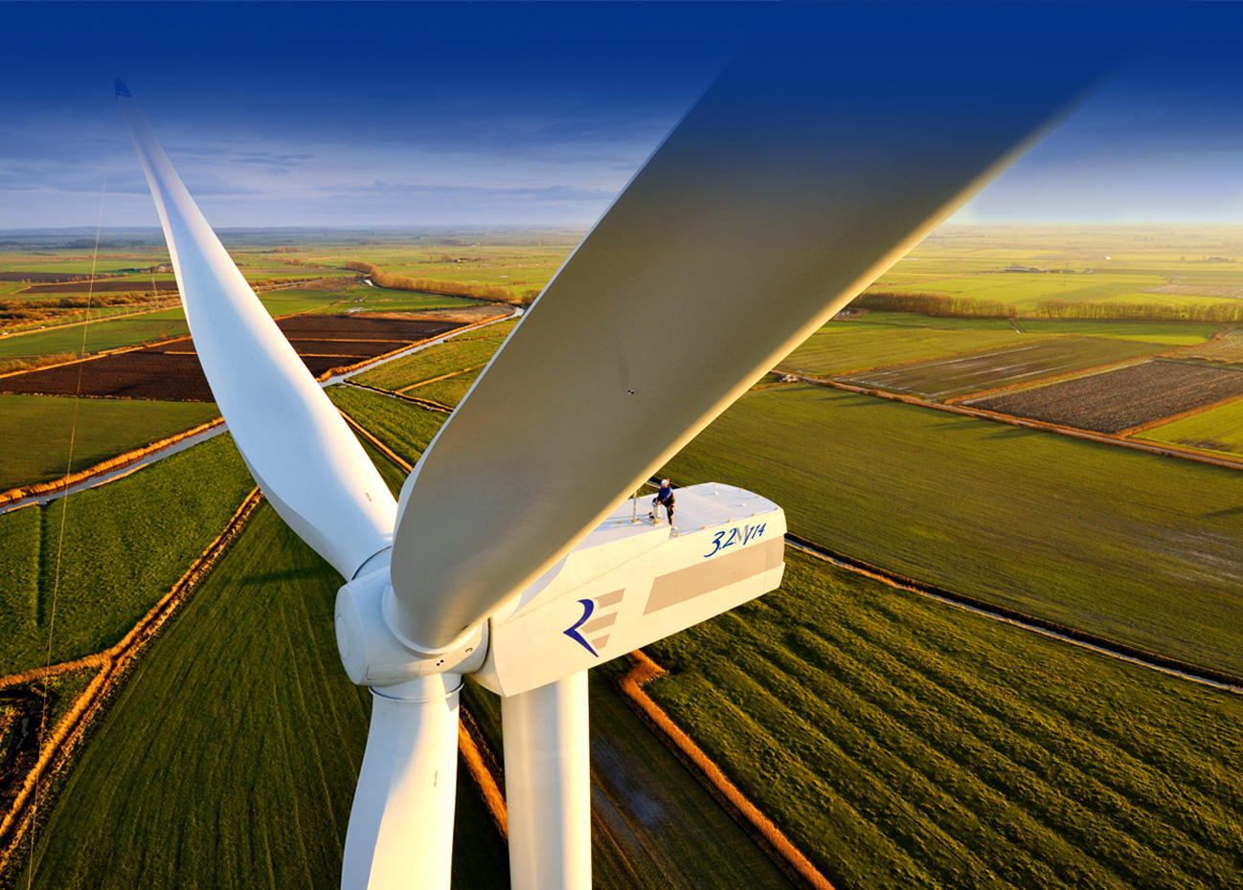
Direct – wind power

Slide 4
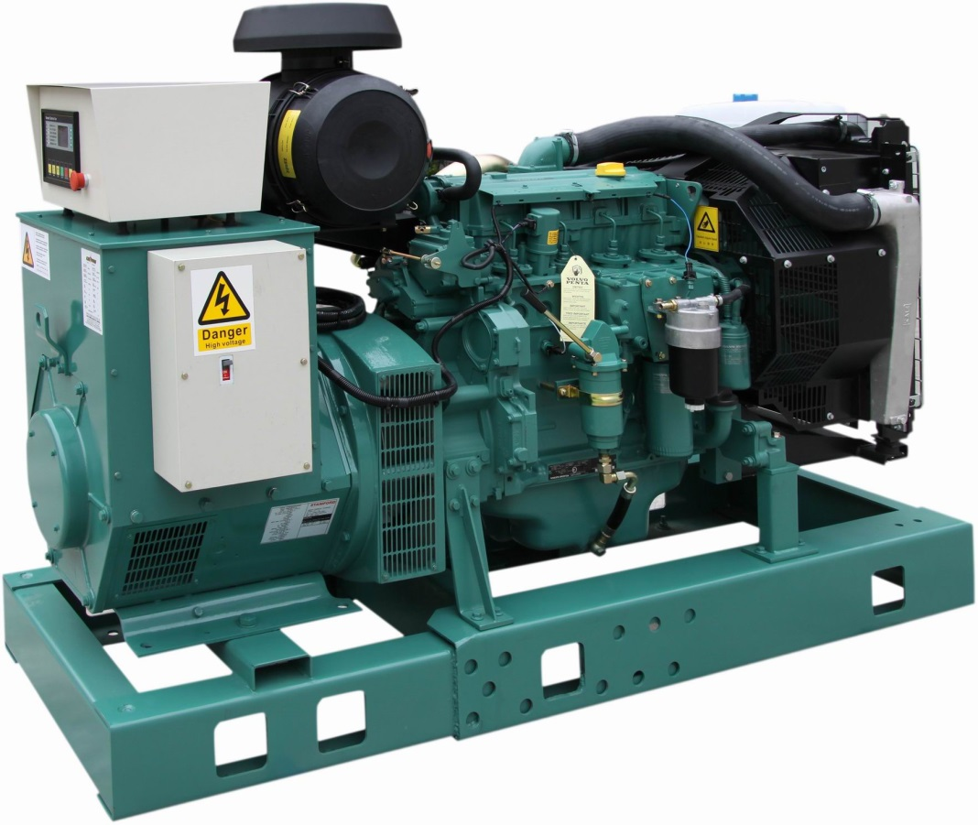
Direct – use an engine

Slide 5
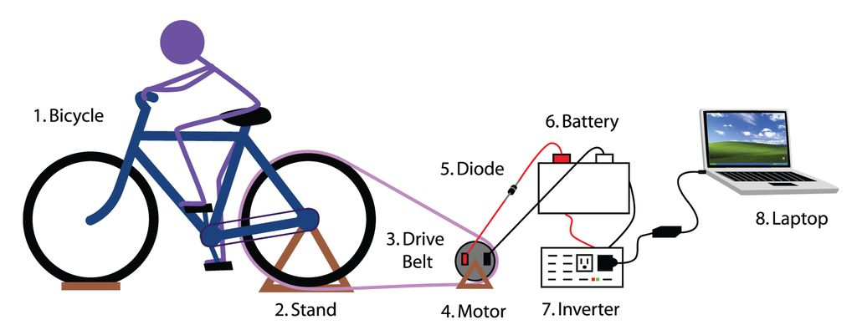
…or a bicycle!!

Slide 6
Indirect – boil water!

Slide 7
Turbine generator
Like all steam turbine generators, the force of steam is used to spin the turbine blades which spin the generator, producing electricity.

Slide 8
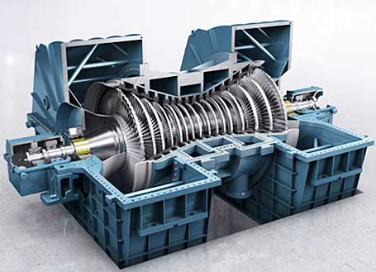
Indirect – steam turbine

Slide 9
How do you boil water?

Slide 10
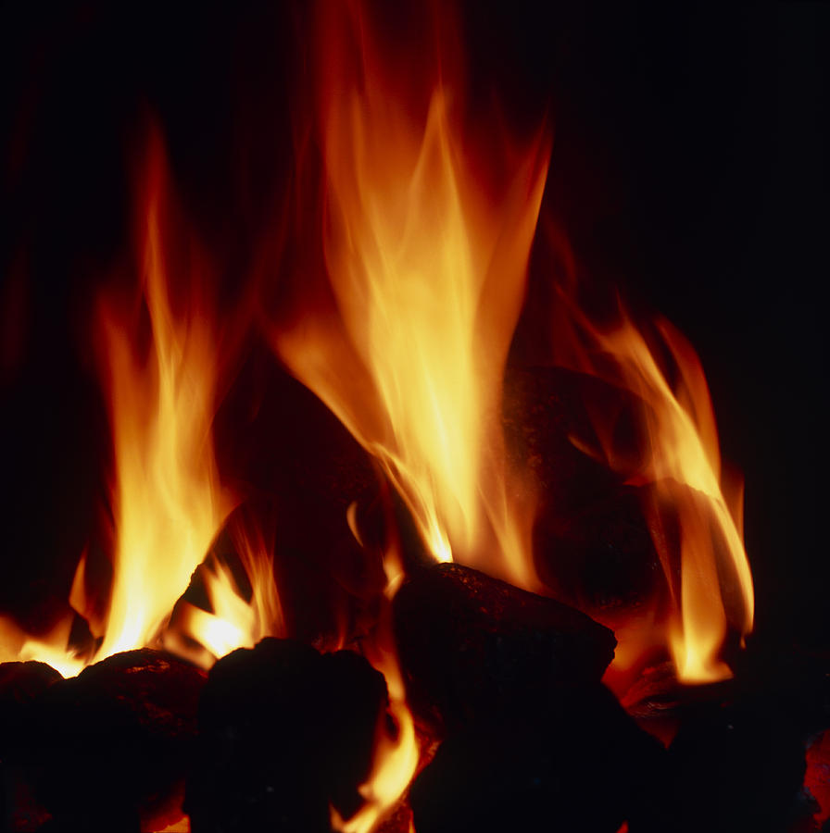
BURN STUFF !

Slide 11
Fossil fuels

Slide 12
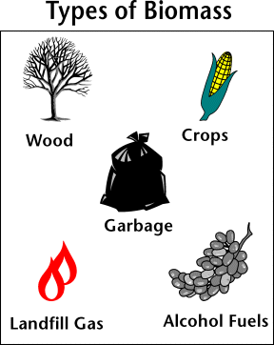
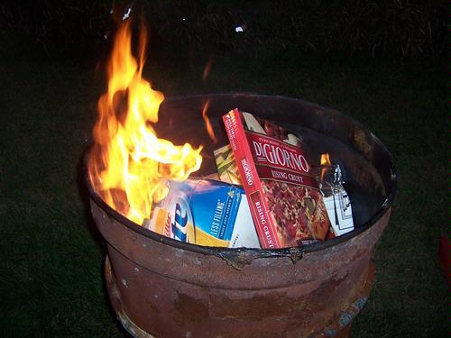
Trash (Tyne’s Bay)
Biomass

Slide 13
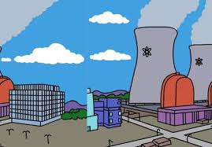
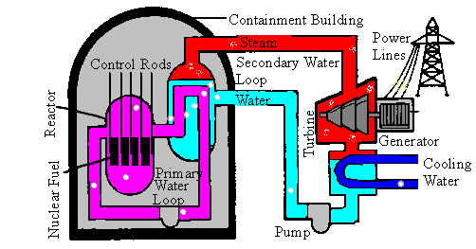
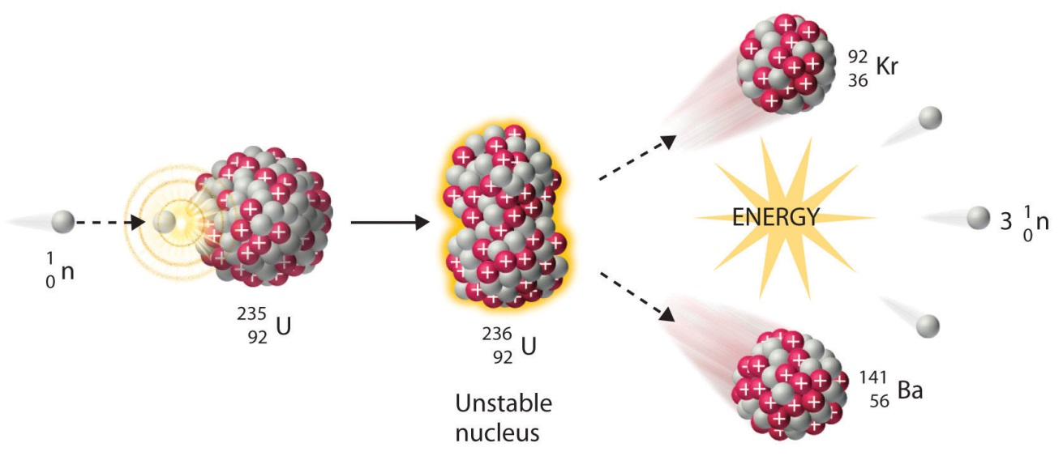
Nuclear Power

