Slide 1
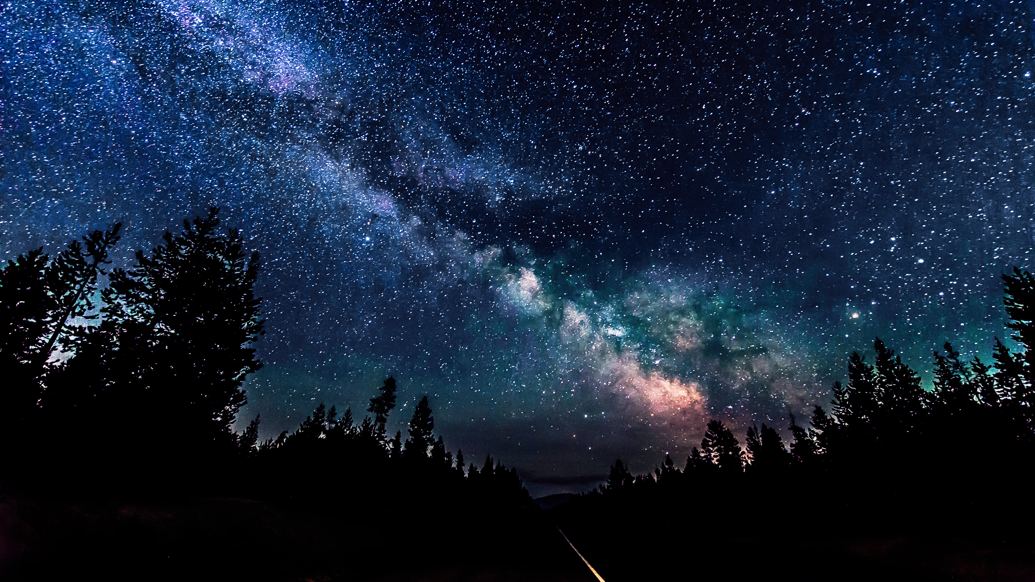
Cosmology

Slide 2
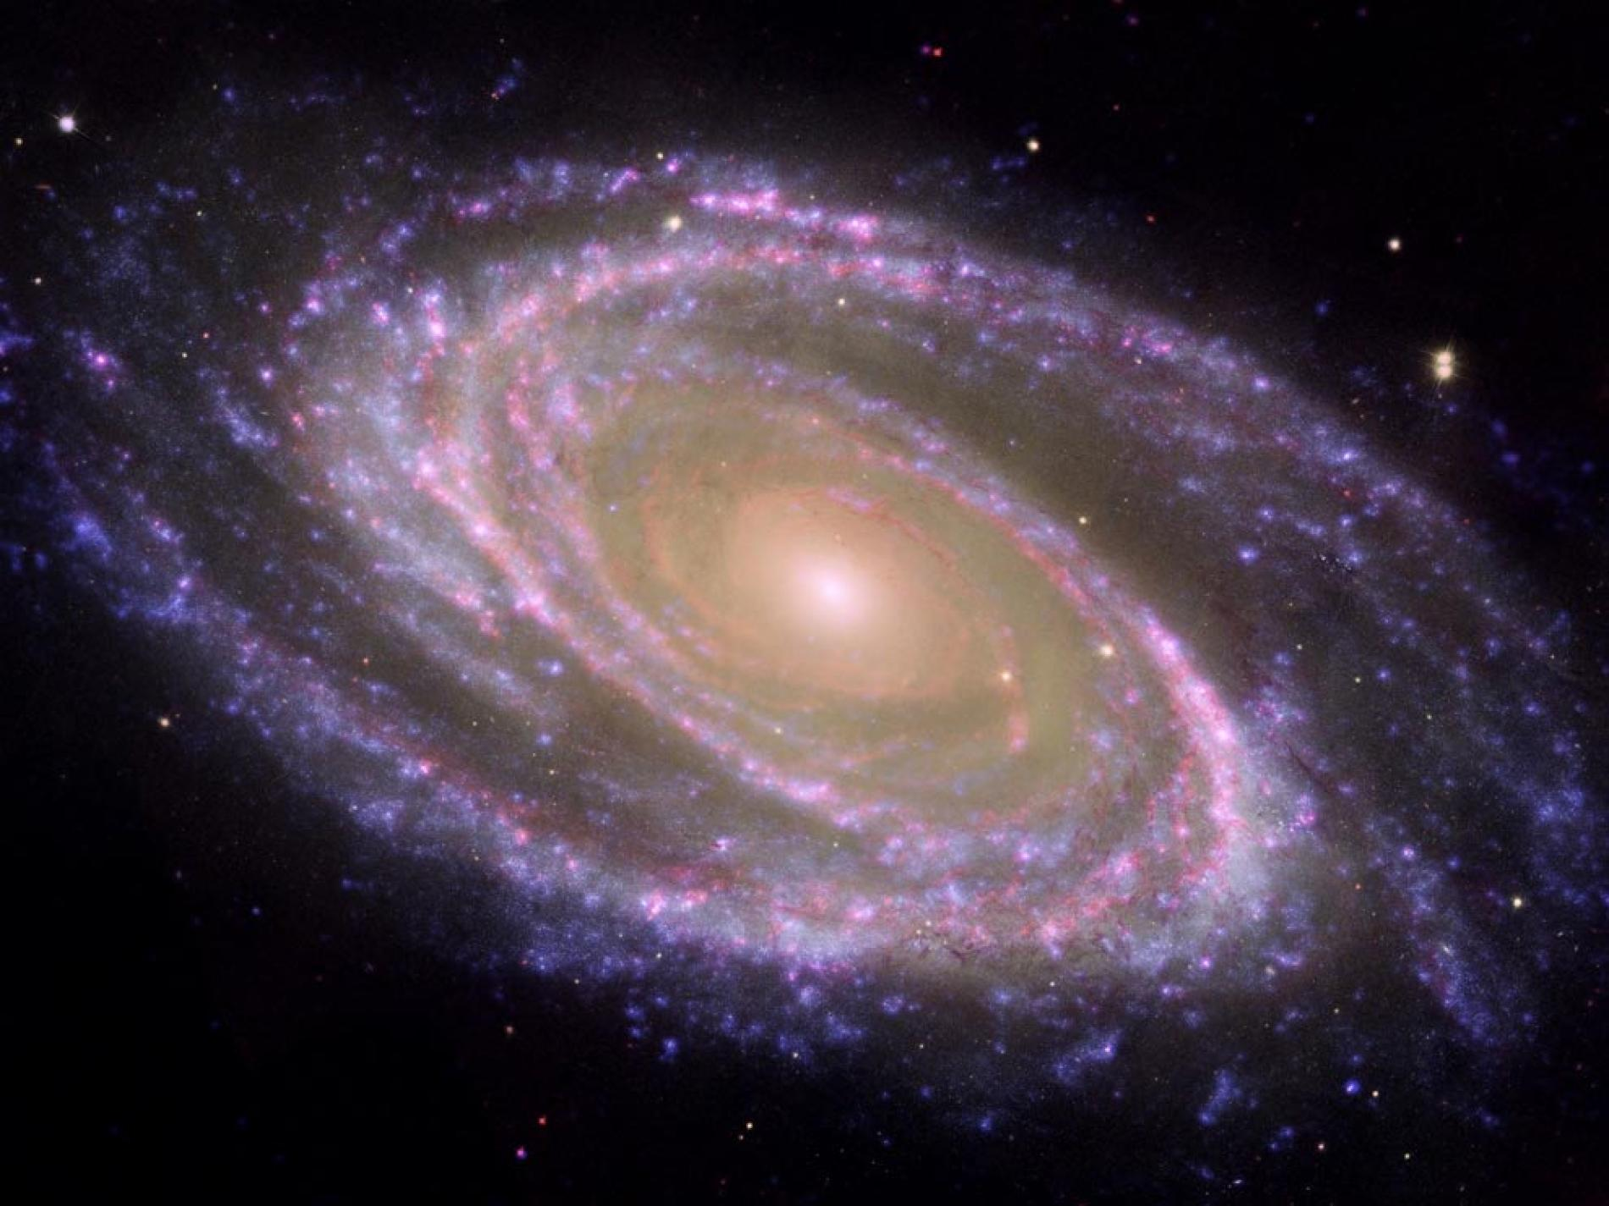
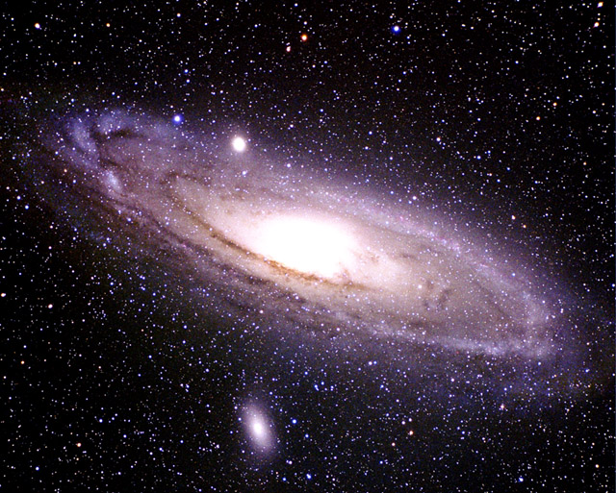
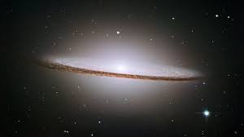
An Infinite Universe?
$$F=\frac{GMm}{r^{2}}$$

Slide 3
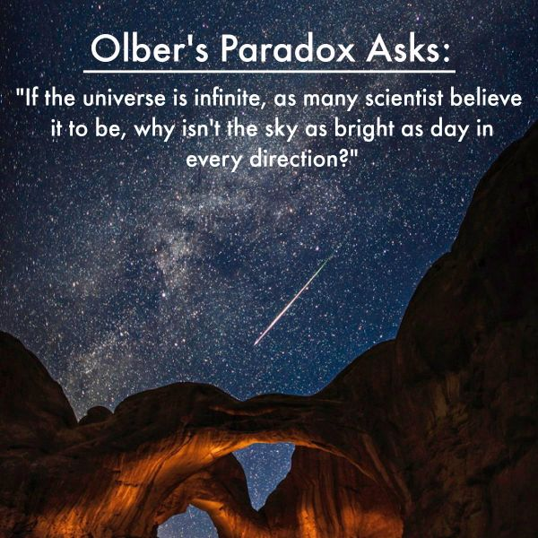
Olber’s Paradox – why is the sky black at night?

Slide 4
Two reasons:
1 – The speed of light is fast, but finite.
2 – The Universe is not infinitely old.
WHICH MEANS?

Slide 5
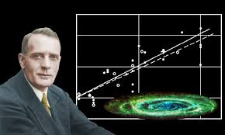
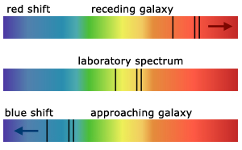
Hubble’s Discovery
Edwin Hubble used a powerful telescope and discovered that the fuzzy galaxies are vast “cities” of stars. He measured the distance to 25 galaxies and discovered that they are moving away from us – from their RED SHIFT. He used the Doppler Effect to calculate their apparent speeds.
Discovered that the recession velocity increases in proportional to their distance from us.
The Universe is expanding!

Slide 6
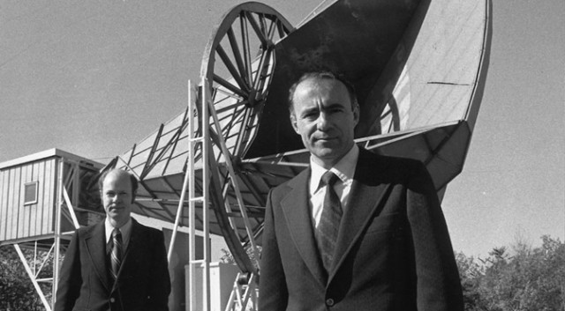
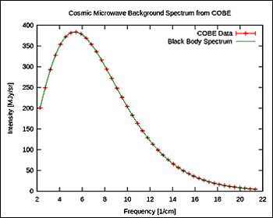
Afterglow of Creation – The Cosmic Microwave Background

Slide 7
Big Bang Theory

Slide 8
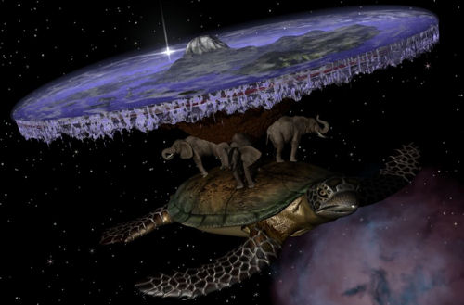
Other Theories?

Slide 9
Actually none yet that can explain the observations….

