Slide 1

Principles of Physics I
BERMUDA COLLEGE
5 – Newton’s Laws (Dynamics)

Slide 2

Forces in Action this Weekend
New tugs arrived!
Physics teacher had hard time kayaking…

Slide 3
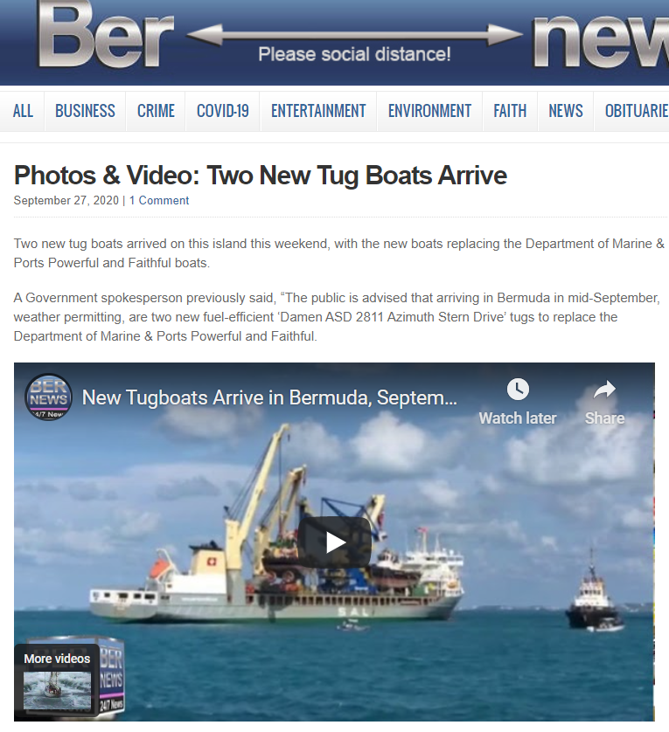
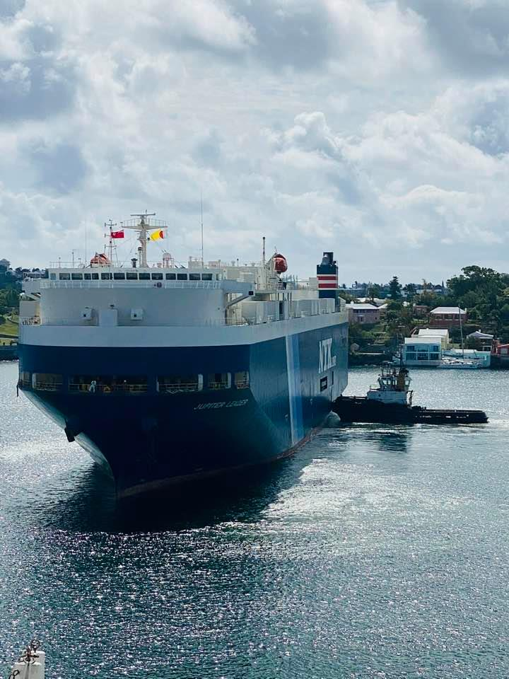

Slide 4
Dynamics
Last week we learned that forces were actions where one object PUSHED and/or PULLED on another.
If there are no forces at all (extremely rare) or if the forces all counterbalance each other, the object’s motion does not change.
This was Newton’s First Law of Motion.
So, what happens when these forces do NOT counterbalance each other?

Slide 5
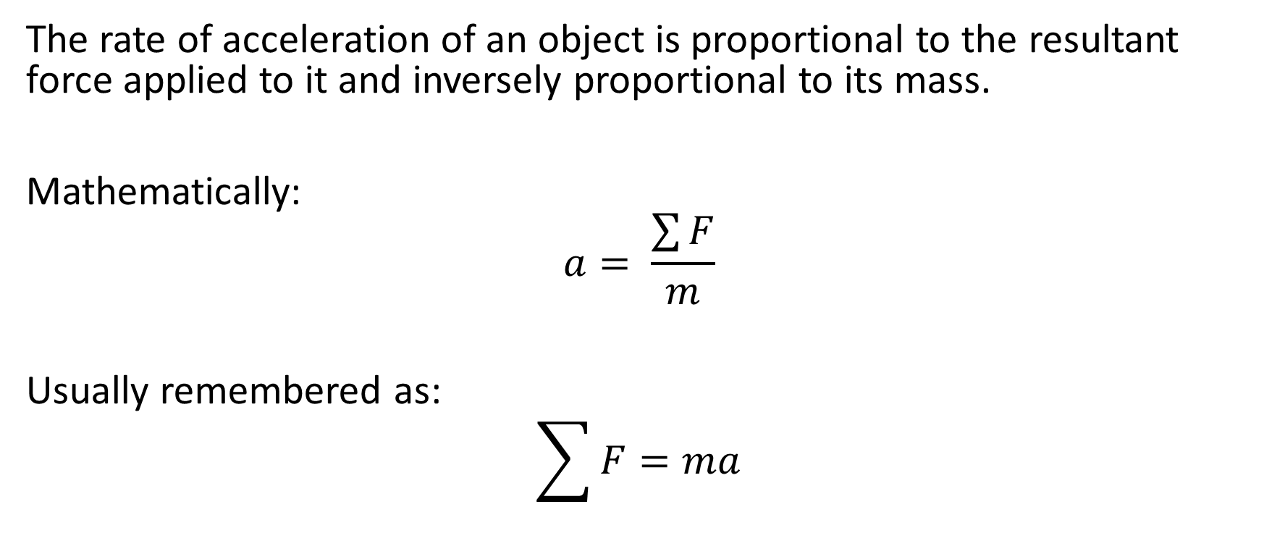
Newton’s Second Law of Motion
The rate of acceleration of an object is proportional to the resultant force applied to it and inversely proportional to its mass.
Mathematically:
$$a= \frac{\sum{F}}{m}$$
Usually remembered as:
$$\sum{F=ma}$$
DYNAMICS

Slide 6
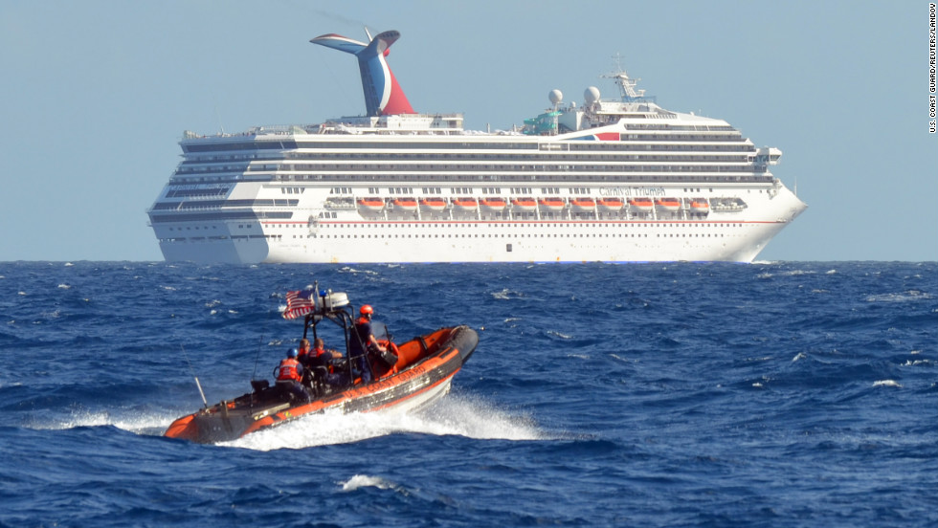

Slide 7
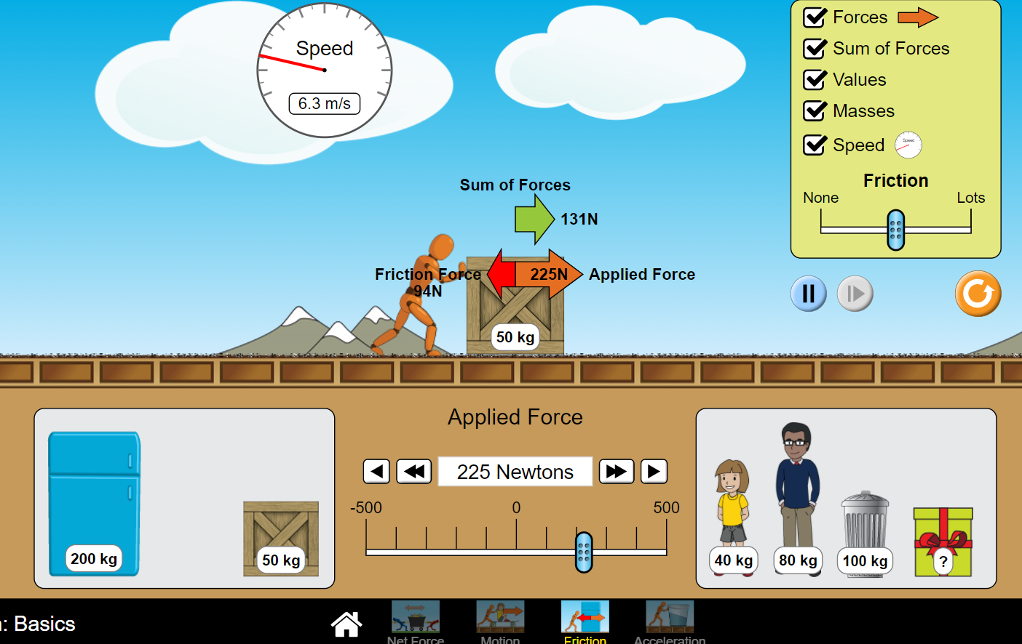

Slide 8
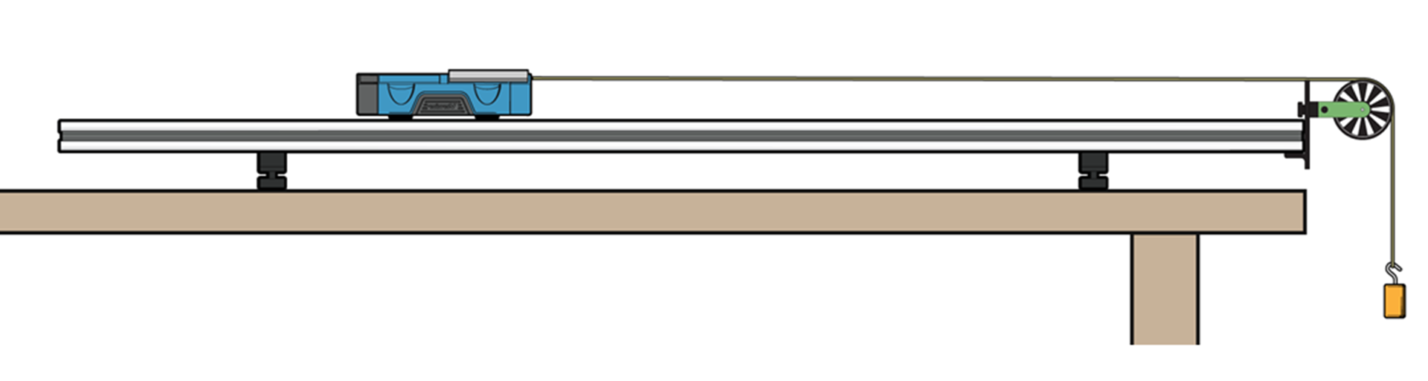
LAB 6 – Newton’s Second Law

Slide 9
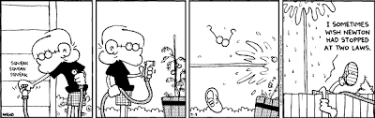
Newton’s Third Law of Motion
“Every action has an equal and opposite reaction”
If an object exerts a force on another object, that object exerts an equal and opposite force on the original object.

Slide 10
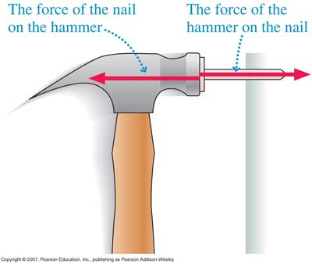
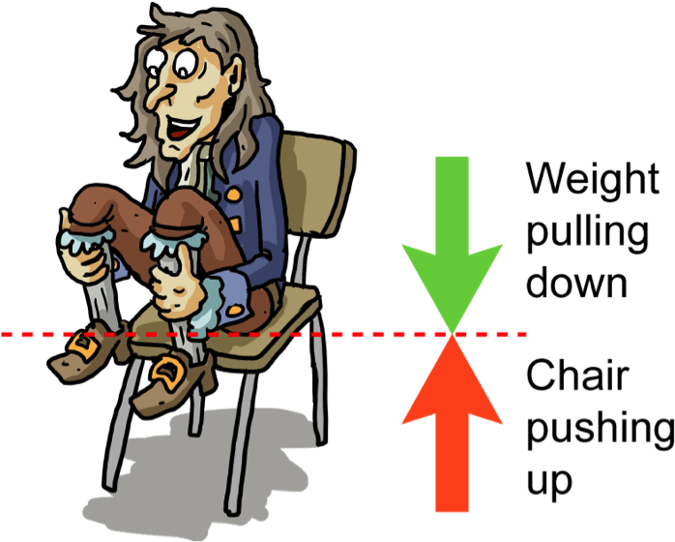

Slide 11
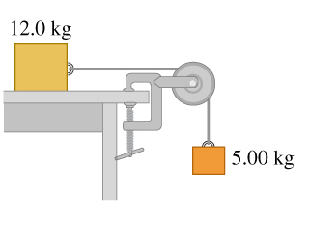
Example 1 – Numerical (+ free-body diagram)

Slide 12
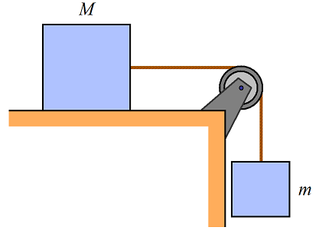
Algebraically (no friction)

Slide 13
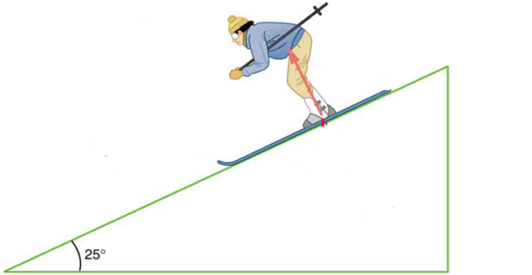
SLOPES – key is to change view

Slide 14
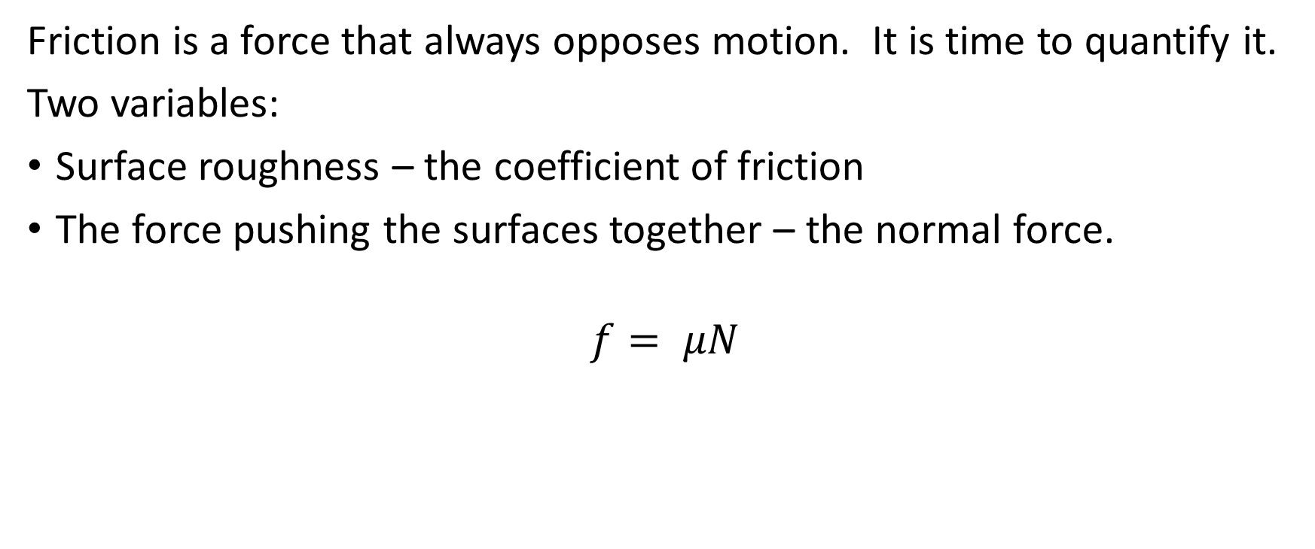
Friction
Friction is a force that always opposes motion. It is time to quantify it.
Two variables:
Surface roughness – the coefficient of friction
The force pushing the surfaces together – the normal force.
$$f= μN$$

Slide 15
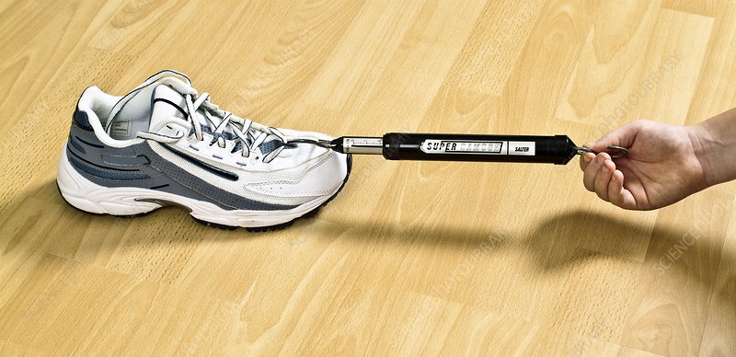
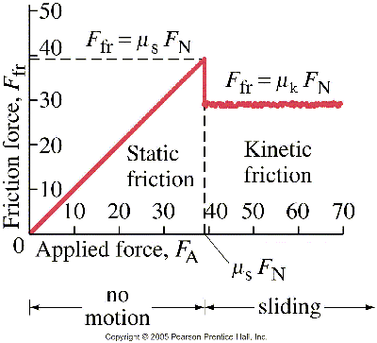

Slide 16
LAB 5
2 experiments:
A – statics, work out the tension in the string
B – N2L, prove that acc is proportional to applied force.

