Slide 1
Time and Tide Wait for No Man….

Slide 2
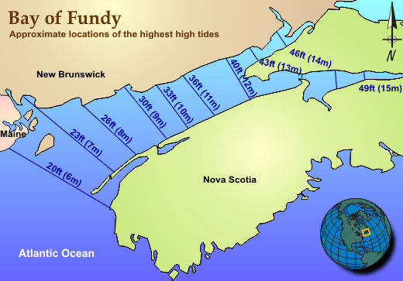
World’s Largest Tidal Range

Slide 3
Bermuda’s Strongest Tidal Current

Slide 5
What Causes the Tides?
The Moon and the Sun
Tidal “bulges” are NOT to scale.
Max height is about 5 m and the oceans are thousands of km across!

Slide 6
Neaps and Springs

Slide 7
Observations
Two tides a day (semi-diurnal)
Tidal ranges are not always the same during the day.
HW one day is about 50 mins after the previous day’s HW.
Tidal range varies with the phase of the Moon.
The sides of the oceans have larger tides than the central parts (e.g. Bermuda)
The Mediterranean has very little tide.
The tidal “bulge” is not exactly under the Moon.

Slide 8
Bermuda’s Tides

Slide 9
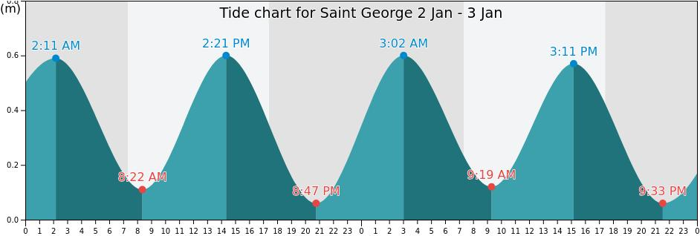
When does the tide flow fastest?

Slide 10
The Moon pulls the water SIDEWAYS not upwards!

Slide 11
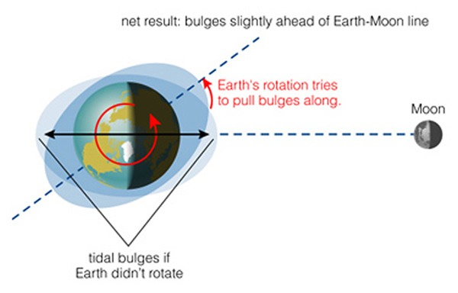
Friction causes HW to be ahead of the Moon’s Zenith

Slide 12
Links
www.weather.bm
https://tides.mobilegeographics.com/locations/668.html
https://www.tideschart.com/Bermuda/Saint-George/

Slide 13
Tidal Model of the Solent, UK

Slide 14
Tides can flow really, really fast

Slide 15
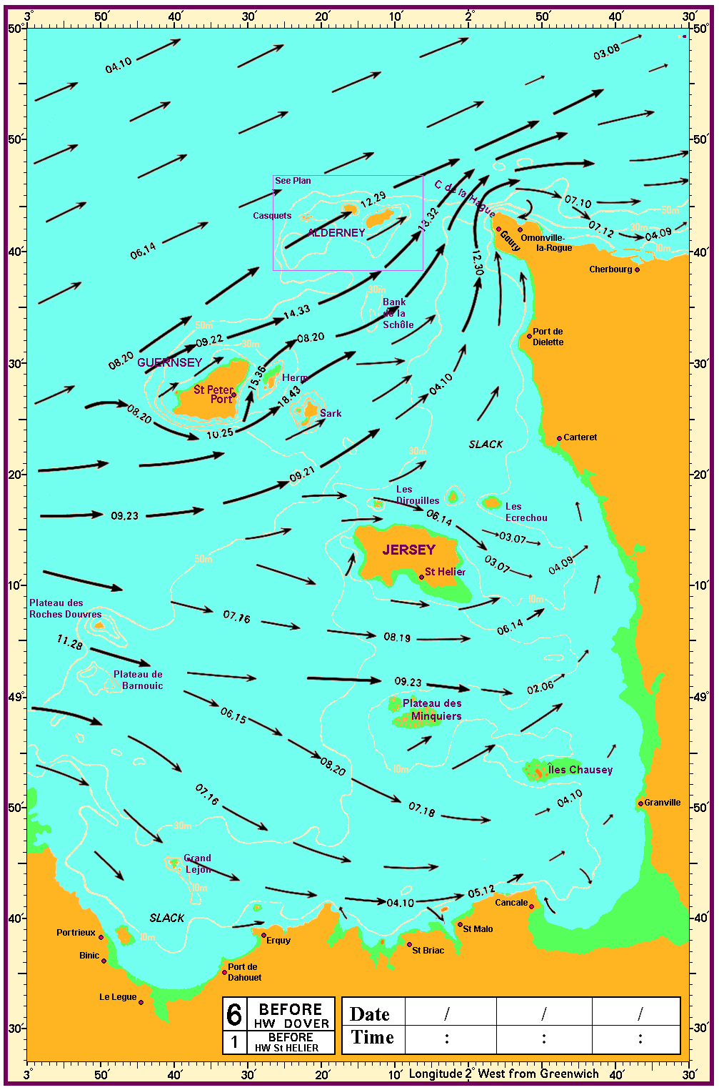
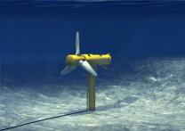
Tidal Energy
https://analysis.newenergyupdate.com/tidal-today/gdf-suez-wins-pilot-tidal-farm-alderney-race

Slide 16
Harmonics
Period of Lunar Tide = 12.42 hrs
Period of Solar Tide = 12.0 hrs
The ‘beats’ are the Spring and Neap tides!

Slide 17
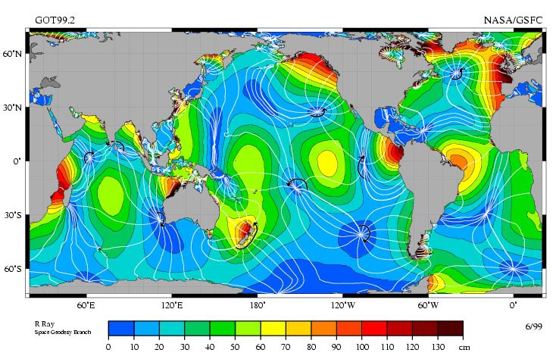
Amphidromic Points
Some parts of the ocean don’t have tides!
Think of this as either ‘sloshing’ or standing waves.

Slide 18
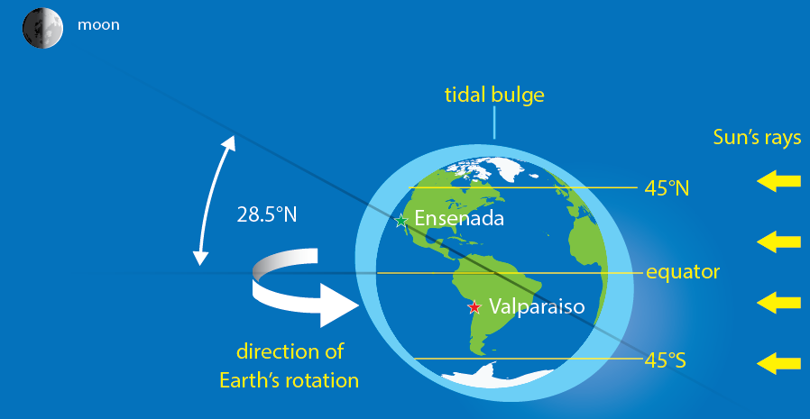
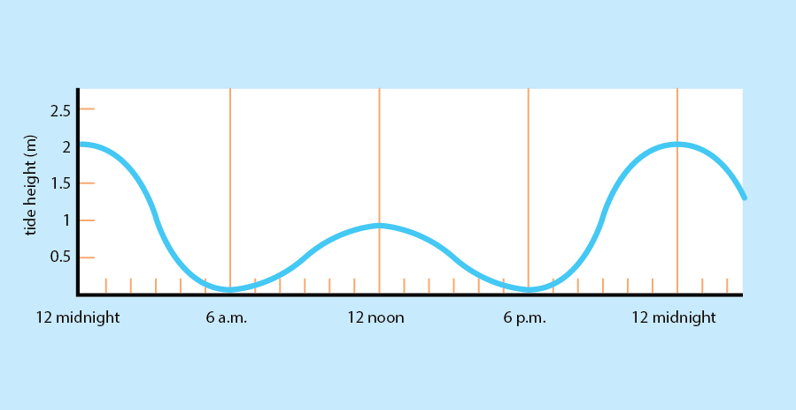
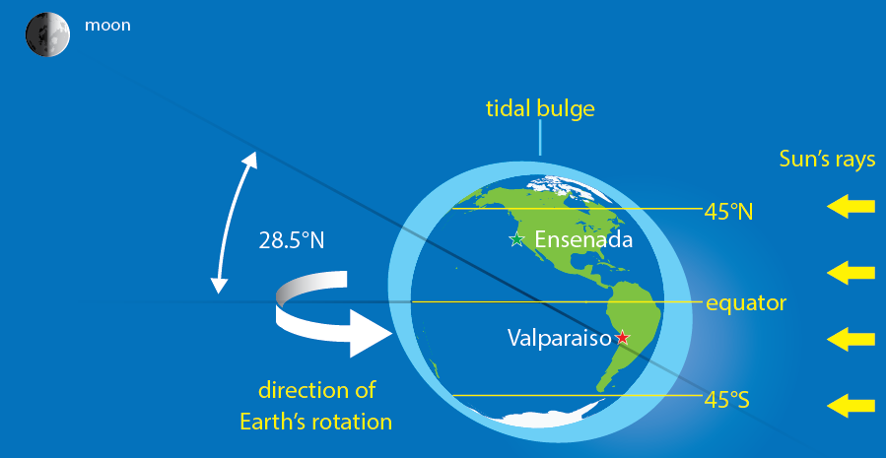
Daily tides can be different
HW in the morning can be a different height than the evening HW.
This is due to the tilt of the Moon’s orbit and the Earth’s axis.

