Slide 1
El Nino
PW

Slide 5
Monday 25 Nov 2019 Which phase are we in?

Slide 6
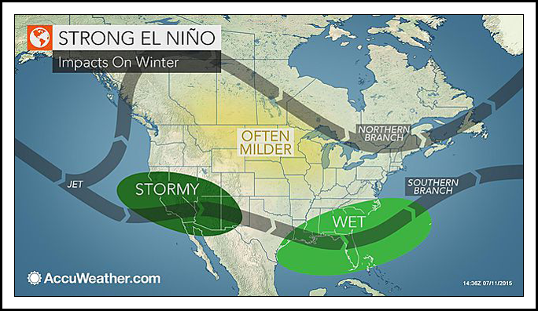

Slide 7
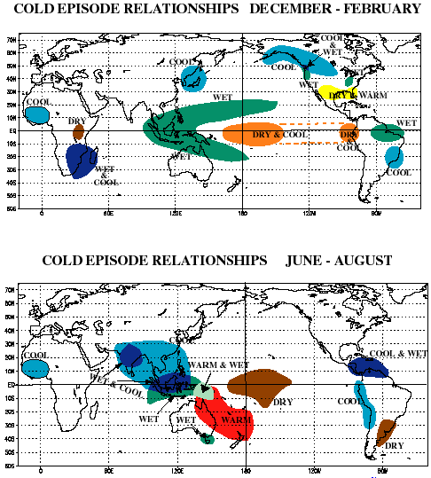
La Nina

Slide 8
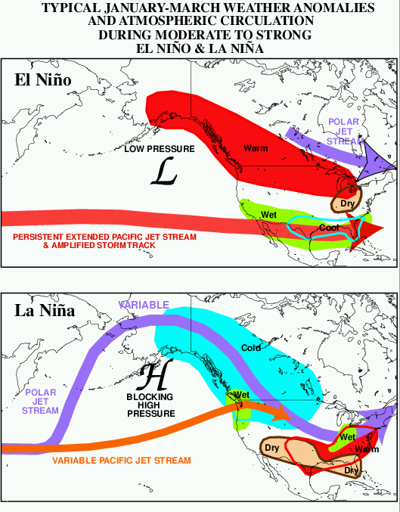
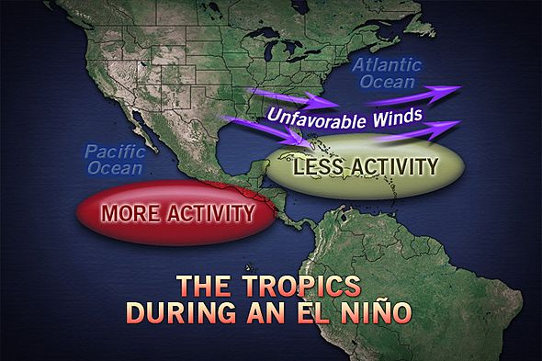
For us: El Nino tends to suppress Atlantic hurricanes, while La Nina tends to increase them.
This is due to the intensification or reduction in upper level wind sheer, that can disrupt the convection cell that powers the hurricane.

Slide 9
ENSO index

