Slide 1
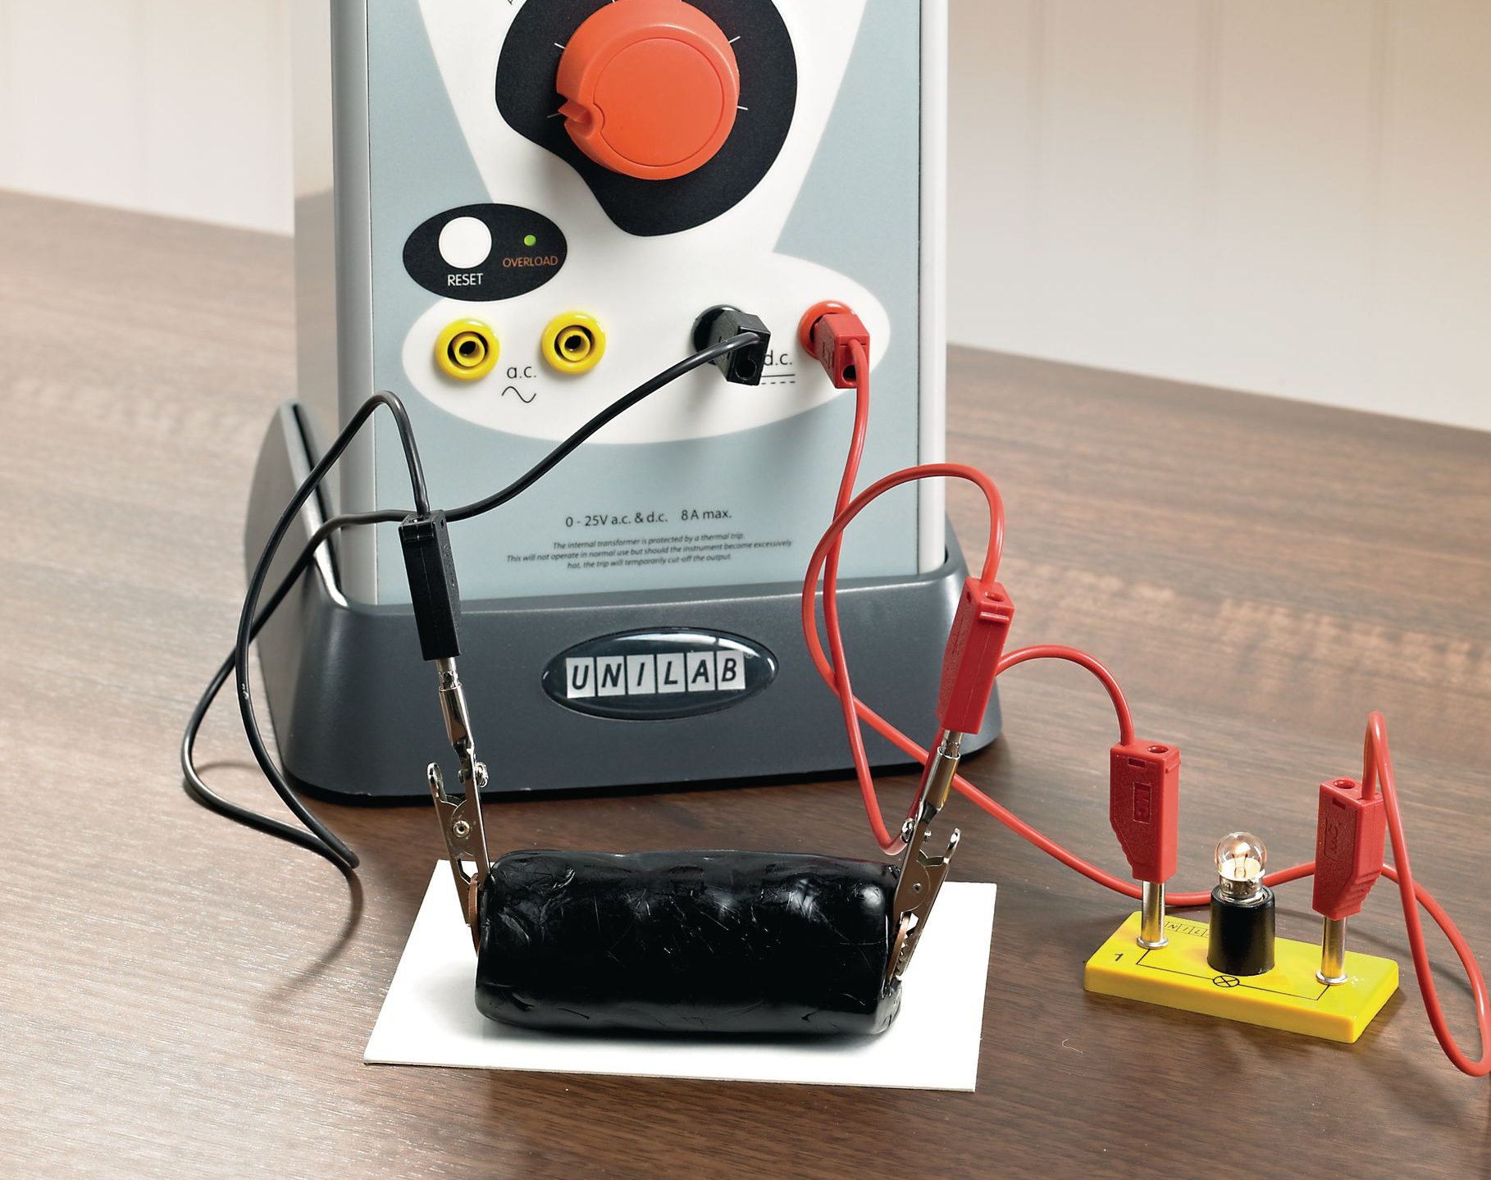
Principles of Physics II
BERMUDA COLLEGE
3.3 – Resistivity

Slide 2
Boatyard problems…
A problem in a boatyard is that the boat can be located a long way from the nearest outlet. Adding lengths of extension cords together results in a slower sander. Why?

Slide 3
Factors that affect the resistance of a wire
This will be your lab work on Friday.
$$R= \frac{ρL}{A}$$
Resistivity – a property of the material
Length of the wire
Resistance
Cross-sectional area of the wire
Question: what are the units of resistivity?

Slide 5
Resistivity and Conductivity
Chemists, Oceanographers and Biologists often talk about the conductivity of a solution, which is a measure of how easily a current can pass through it. It is the reciprocal of the resistivity. The higher the concentration of ions, the greater the conductivity.
$$σ=\frac{1}{ρ}$$

Slide 6
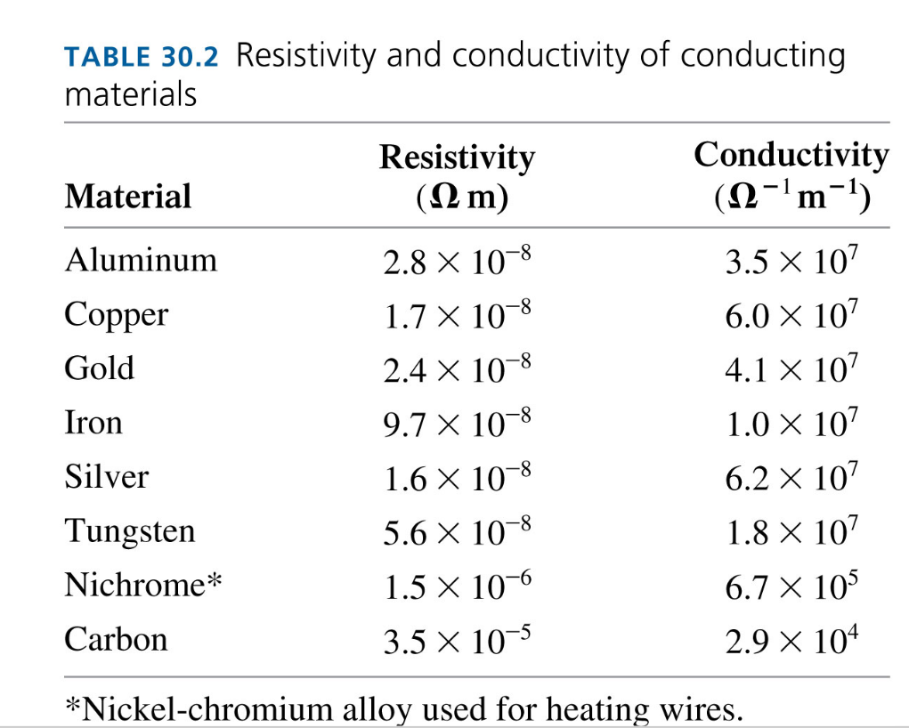

Slide 7
EXAMPLE
Eighteen-gauge wire (SWG 18) has a diameter of $1.024 \text{mm}$. Calculate the resistance of $15 \text{m}$ of wire. $ρ_{Cu}=1.7×{10}^{−8}\text{Ω}\text{m}$

Slide 8
How thin is the filament?
The filament in a bulb is made from tungsten wire. It is 2.0 cm long and has a resistance of 0.05 Ω
$$ρ_{W}=5.6 ×{10}^{−8}\text{Ω}\text{m}$$

