Slide 1
Global Heating and Atmospheric Circulation
SGY 2 - Oceanography

Slide 2
Earth is unevenly heated

Slide 3
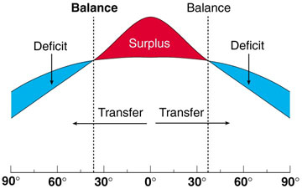

Slide 4
Seasons

Slide 6
Convection in a perfect non-rotating world.

Slide 8
Convection over the tropics - ITCZ

Slide 9
Coriolis Effect

Slide 10
Coriolis Effect

Slide 11
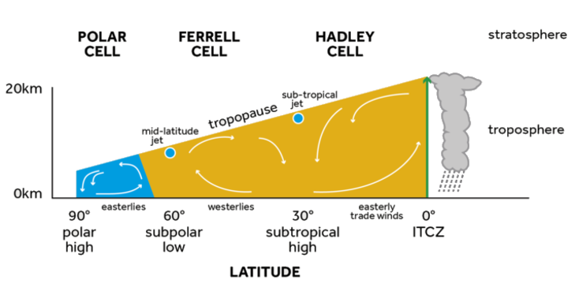
3 cells!

Slide 12
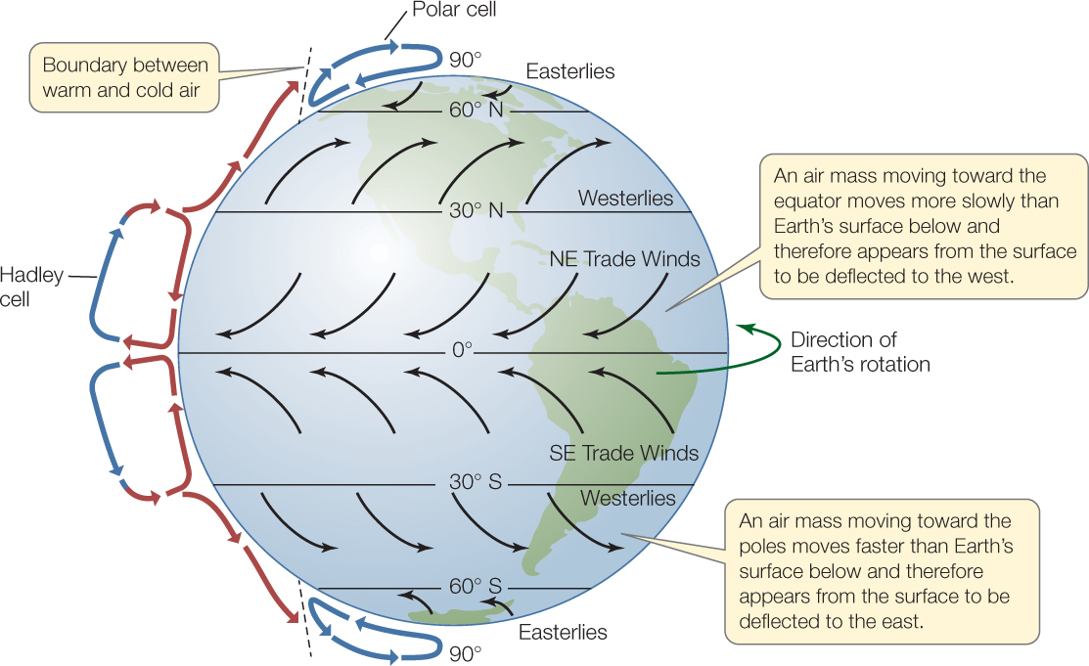

Slide 13
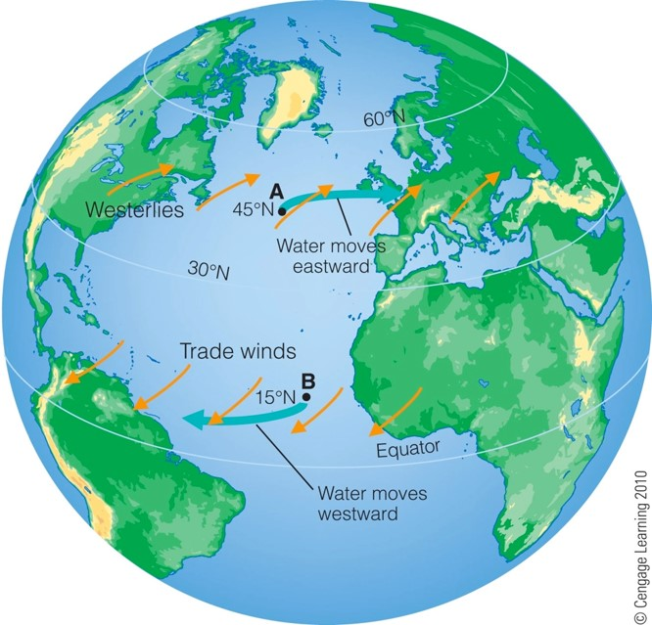
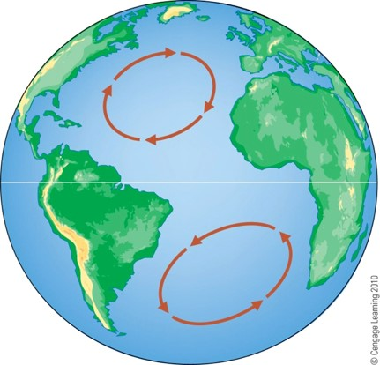

Slide 15
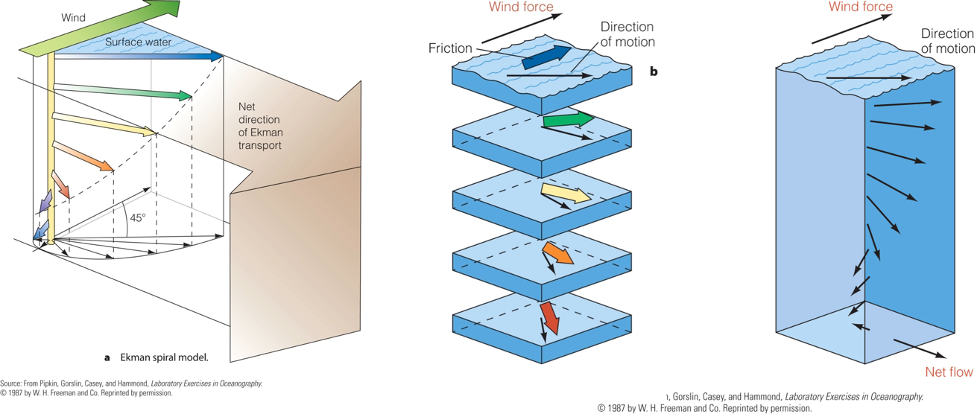
Wind-driven surface currents – Ekman Spiral

