Slide 1
Principles of Physics II
BERMUDA COLLEGE
2.5 – The Gas Laws

Slide 2
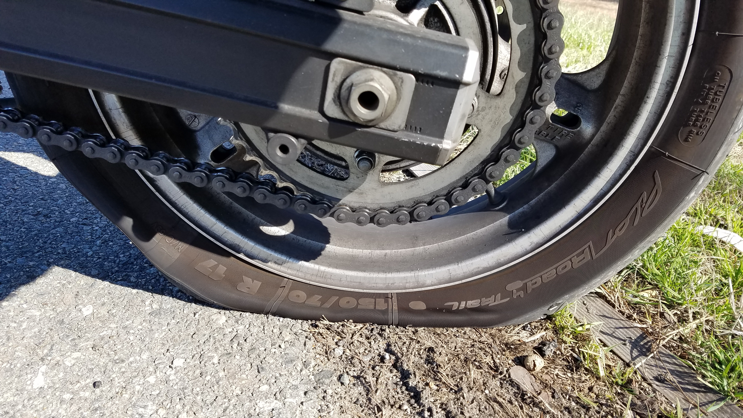
What makes gases special?
They are compressible and so their density can change.
The pressure can vary.

Slide 3
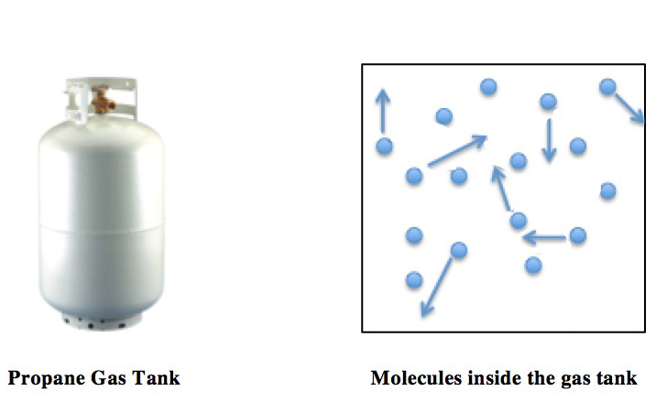
Gases are made from particles (atoms and molecules) that are not bonded to each other and are free to move. The spaces between them are much greater than the size of the particles.
Gases occupy the volume of their container.

Slide 4
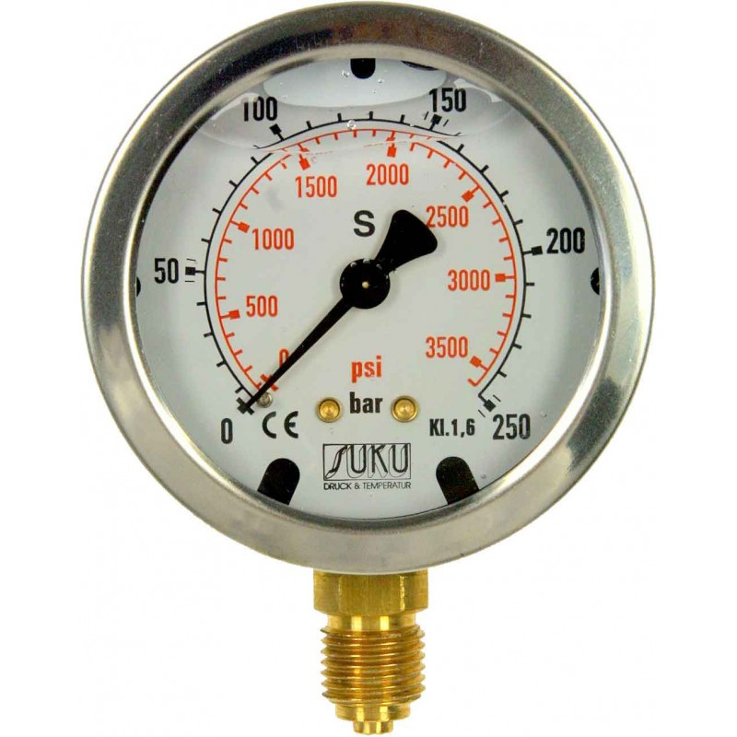
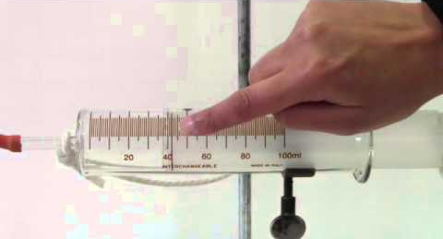
Macroscopic Variables
There are three macroscopic variables that are easily measured:
Pressure
Volume
Temperature *** this must be in Kelvins ***

Slide 5
What is Gas Pressure?
The particles move around at great speed.
When they hit each other or the walls of their container, they exert a force. This force spread over the area of the walls is a pressure.
The faster and/or more rapidly they hit the walls, the higher the pressure.

Slide 6
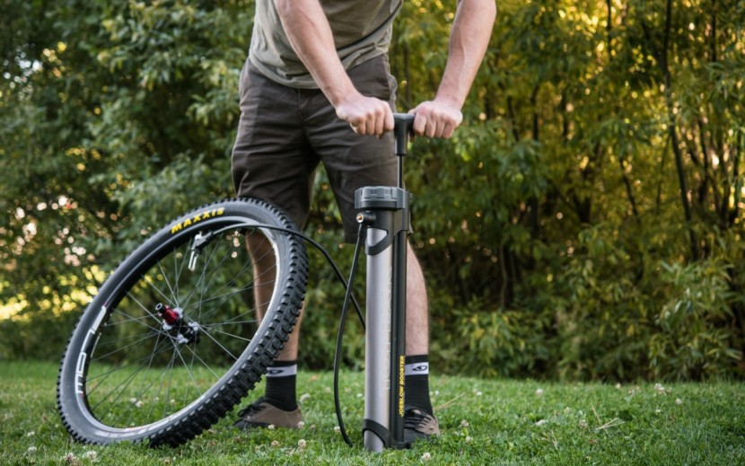
How to increase pressure?
There are THREE ways to increase the pressure of a gas:
Heat it
Squash it
Pump it

Slide 7
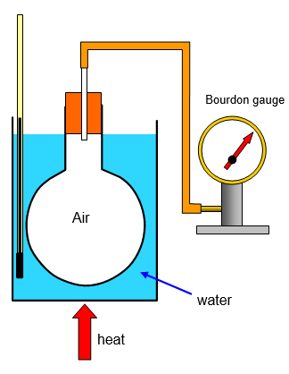
We generally don’t consider the pumping one…
Heating a gas: the particles have more kinetic energy so hit the walls faster and more often. The pressure increases. This is known as the pressure law!
$$\frac{P_{1}}{T_{1}}=\frac{P_{2}}{T_{2}}$$

Slide 8
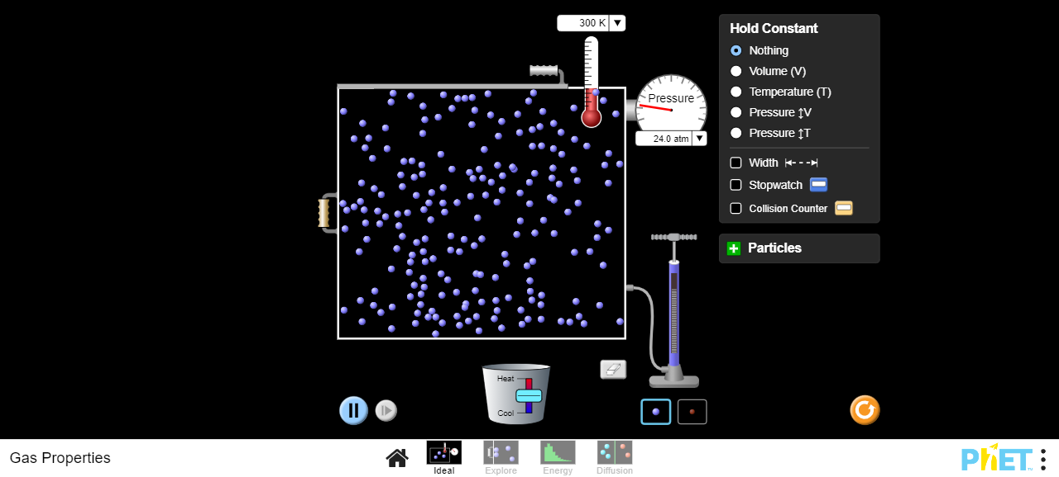
CUT TO DEMO AND SIMULATION
https://phet.colorado.edu/sims/html/gas-properties/latest/gas-properties_en.html

Slide 10
EXAMPLE
One mole of gas enclosed in a 40 litre contained at 300 K is supplied with energy until its temperature is 450 K. What is the final pressure of the gas?

Slide 11
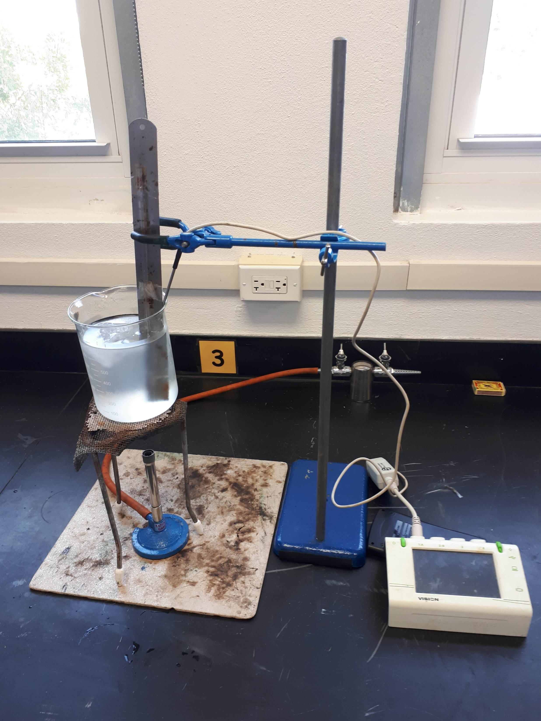
Charles’ Law
If you heat a gas at a constant pressure, it expands as the particles push the walls outwards.
$$\frac{V_{1}}{T_{1}}=\frac{V_{2}}{T_{2}}$$

Slide 12
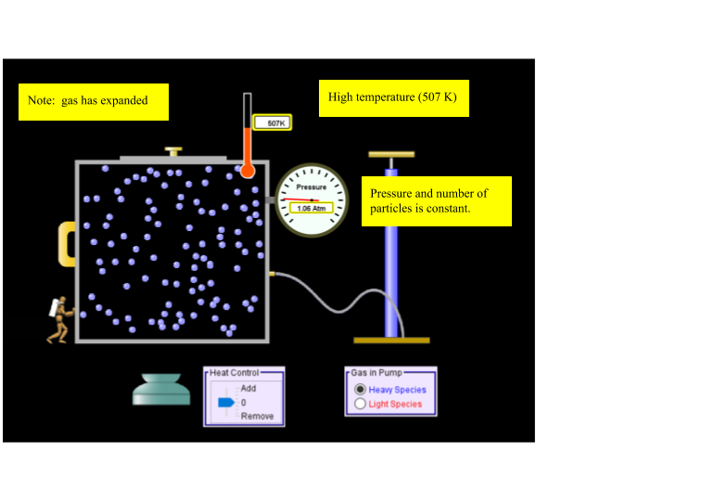
Cut to demo and simulation

Slide 13
EXAMPLE
A balloon has a volume of 10 litres at room temperature. Assuming that the elasticity of the rubber remains fixed and hence the pressure difference between the inside and the outside remains constant, calculate the new volume when the balloon is cooled down in a freezer to -10°C.

Slide 14
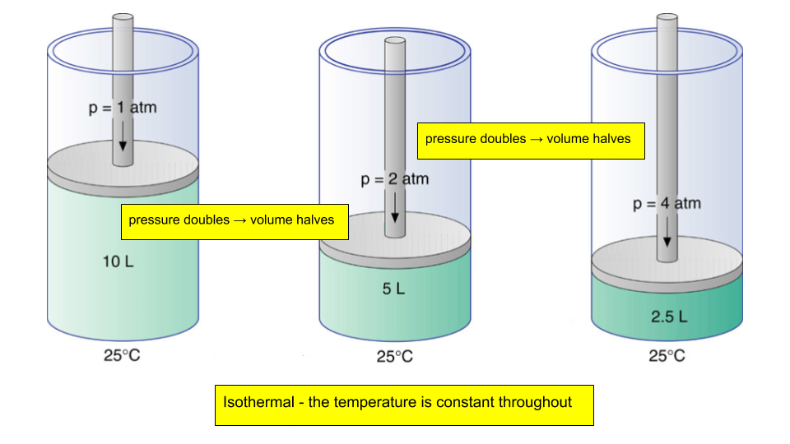
Boyle’s Law
If you squash a gas, it gets smaller.
$$P_{1}V_{1}=P_{2}V_{2}$$

Slide 15
CUT TO DEMO AND SIMULATION

Slide 16
EXAMPLE
A diving cylinder contains 12 litres of compressed air at a pressure of 20 atm. When it is released the pressure drops to 1 atm so that it can be breathed in by the diver. Assuming that the air in the bottle and outside the bottle are at the same temperature, calculate the volume of the low pressure air.

Slide 17
Combine these to ONE law
$$\frac{{P_{1}V}_{1}}{T_{1}}=\frac{{P_{2}V}_{2}}{T_{2}}$$
CUT TO SIMULATION

Slide 18
EXAMPLE
An ideal gas has a volume of 100 cm³ at 2.00 × 10⁵ Pa and 27°C. What is its volume at 5.0 × 10⁵ Pa and 60 °C?

Slide 19
The Ideal Gas Law
Given that for a fixed mass of gas, the ratios of the pressure, volume and temperature are inter-related, a surprising fact is that it does not actually matter WHAT the gas is! Scientists found that the amount of the gas is the deciding factor:
$$PV=nRT$$
Pressure in PASCALS
Temperature in KELVINS
Volume in cubic meters
The GAS CONSTANT
Number of MOLES

Slide 20
EXAMPLE
A gas above atmospheric pressure at 1.7 × 10⁵ Pa and temperature 400 K has a volume of 1.3 litres. Calculate the number of moles of gas. If the pressure falls back to normal atmospheric pressure whilst the volume expands to 2.0 litres, what is the final temperature?

