Slide 1
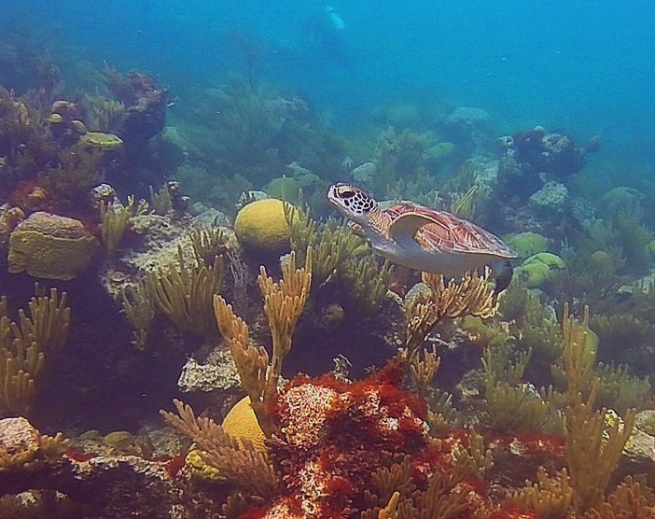
Principles of Physics II
BERMUDA COLLEGE
1.3 – Archimedes’ Principle

Slide 2
Archimedes’ Principle is my favorite law of physics. It is also the oldest. It is the only law of nature that was describe by the Ancients that is actually correct. It is the law that describes how buoyancy (upthrust) works. This does not just apply to boats, divers and fish, but also drives the convection currents which cause weather, climate and ocean currents. Mathematically, it is also elegant yet simple!

Slide 3
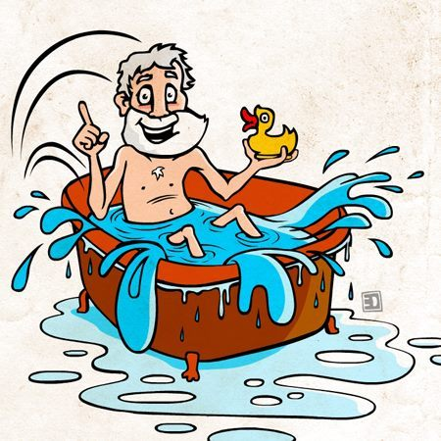
EUREKA!
Students often remember the story of Archimedes jumping into a full bath and the water overflowing.
This is not Archimedes’ Principle though. But, the displacement of the water did allow him to measure the volume of a submerged object and led him to realise why objects float or sink.

Slide 4
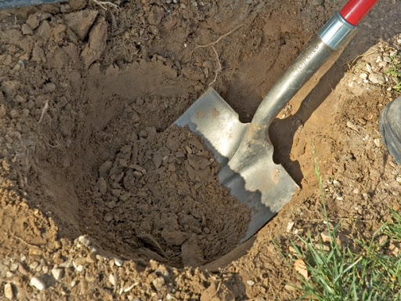
Digging a Hole
It is relatively easy to dig a hole in a solid such as soil. As you lift the soil out, the sides remain still and a hole is formed where the soil used to be.
Home lab: try doing this with water.

Slide 5
When an object is placed in water, it displaces some of that water due to its volume.
It also experiences an upwards force that is known as buoyancy (old school) or upthrust (new school).
If the buoyancy = weight, it floats!
If the buoyancy < weight, it sinks….
All problems are ultimately based on forces up and down
If not moving:
$\sum{F}↑=\sum{F}↓$

Slide 6
Buoyancy force (upthrust) is exactly equal to the weight of the water that would have occupied this space.
So, in order to calculate the force of buoyancy, we need to calculate the weight of the water displaced:
$$F_{B}=mg$$
As mass = density x volume we get:
$$F_{B}=ρVg$$
Important – the density and volume are that of the water, not the solid.

Slide 7
Buoyancy force (upthrust) is exactly equal to the weight of the water that would have occupied this space.
So, in order to calculate the force of buoyancy, we need to calculate the weight of the water displaced:
$$F_{B}=mg$$
As mass = density x volume we get:
$$F_{B}=ρVg$$
Important – the density and volume are that of the water, not the solid.
This bit is the sticky bit…

Slide 8
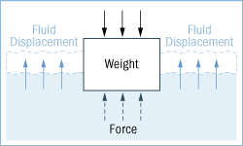
What causes this upwards force?
Ultimately it is the difference in the hydrostatic pressure due to the difference in the depth of the bottom of the submerged volume and the top. Remembering that,
$$P=\frac{F}{A}$$
$$F_{B}=F_{bottom}−F_{top}$$
$$F_{B}=P_{bottom }A−P_{top }A$$
$$F_{B}=∆P×A$$
$$F_{B}= ρg∆h ×A$$
Volume = area x height, which gives:
$$F_{B}=ρVg$$

Slide 9
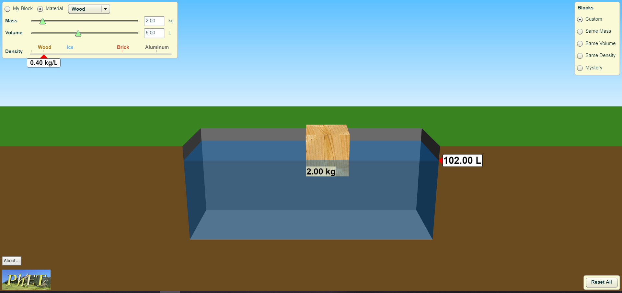
So, why does wood float?
Original water ‘level’ = 100 L

Slide 10
So, why does wood float?
$$V_{submerged}=2.00 L$$
We know that 1.0 L of water has a mass of 1.0 kg, so:
$F_{B}=weight of water displaced$
$$F_{B}=2.0 \text{kg}×g=20 \text{N}$$
Which is equal to the weight of the block.
Original water ‘level’ = 100 L

Slide 11
So, why does wood float?
Another way:
Block is not moving up or down, so $\sum{F=0. }$
$$F↑=F↓$$
$$F_{B}=mg$$
$$F_{B}=2.0 \text{kg}×g=20 \text{N}$$
Original water ‘level’ = 100 L

Slide 12
So, why does wood float?
In terms of density:
$$F↑=F↓$$
$$ρ_{w}Vg=mg$$
As we know that mass = density x volume, we have:
$$ρ_{water}V_{water}g=ρ_{wood}V_{wood}g$$
$$\frac{V_{water}}{V_{wood}}=\frac{ρ_{wood}}{ρ_{water}}$$
If volume of water that needs to be displaced exceeds that of the object, it sinks.
Original water ‘level’ = 100 L

Slide 13
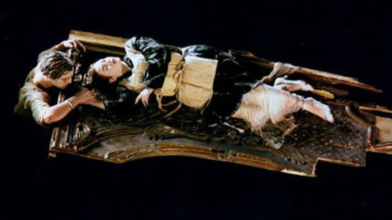
The Raft Problem

Slide 14
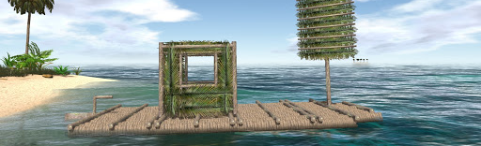
Desert Island Escape
Dimensions are: Length = 8.0 m, width = 4.0 m and depth = 1.0 m
Raft is made from coconut palm trees which have a mean density of $400 \text{kg}\text{/}{\text{m}}^{3}$. The mean density of seawater = $1029 \text{kg}\text{/}{\text{m}}^{3}$
If the average mass of a student is 60 kg, how many students can the raft carry?

Slide 15
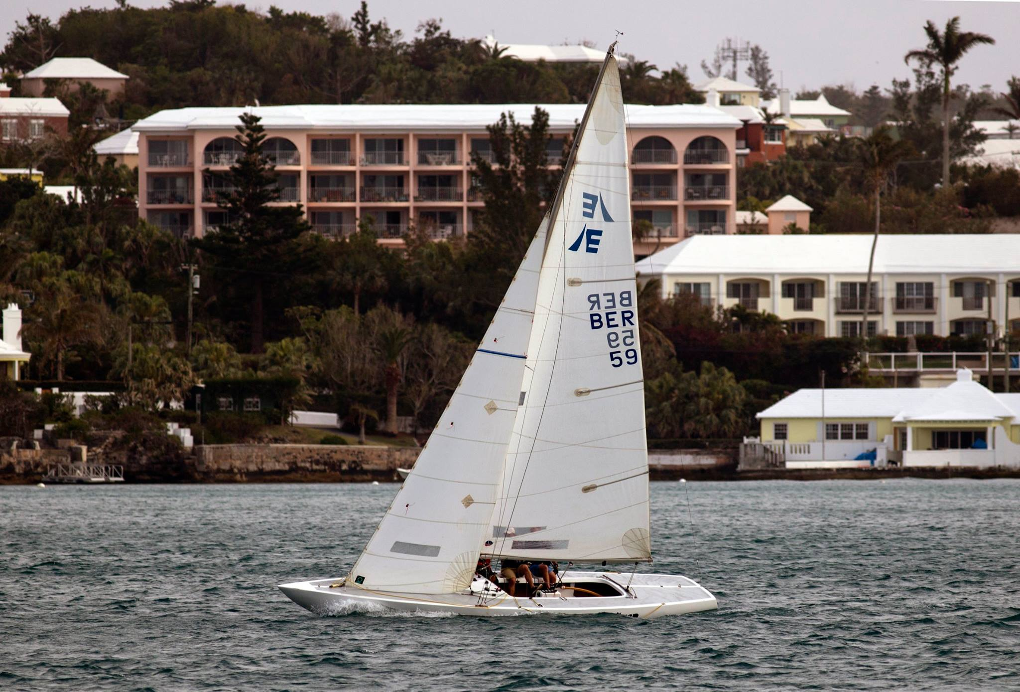
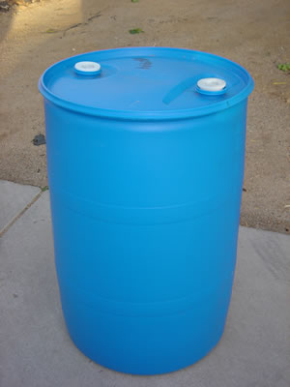
Raising a Wreck
It is possible to raise a wreck by strapping bags or barrels to it and filling them with air from dive tanks.
Question: How many barrels would be needed to raise an Etchells from the bottom?
Mass of Etchells = 3,325 lbs (1,508 kg)
Volume of barrel = 55 gallons (208 litres)

Slide 16
Challenge
What happens to the water levels in the glasses when the ice melts and why?

