Slide 1
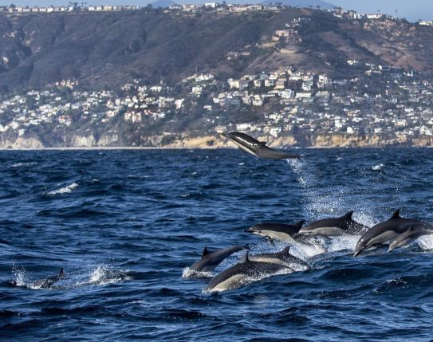
Oceanography
1.2 – A History of Marine Science

Slide 2
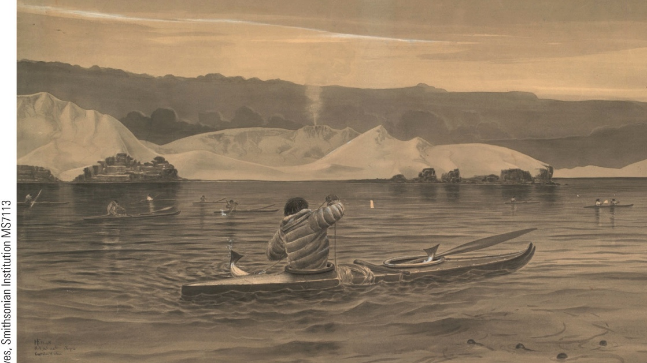
Understanding the Ocean Began with Voyaging for Trade and Exploration
Natives of Alaska’s Aleutian Islands fish in kelp forests. Settlers able to exploit offshore resources had nutritional and strategic advantages over their landlocked competitors.

Slide 3
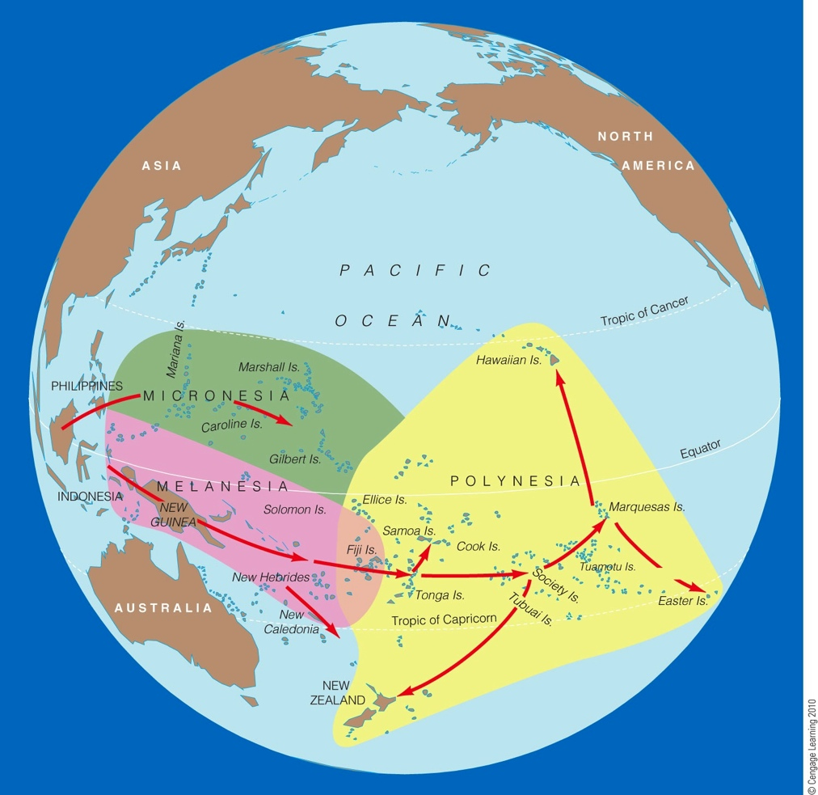
Ocean Seafarers Colonized Distant Islands
The Polynesian triangle. Ancestors of the Polynesians spread from Southeast Asia or Taiwan to New Guinea and the Philippines by about 6,000 years ago. Central Polynesia was settled around 1000 B.C.E., but the explosive dispersion that led to the settlement of Hawai’i occurred about 450 - 600 A.D.
The Polynesian colonization's are an example of knowledge of oceans and marine science used to colonize a vast number of islands.
“Red Arrows” show a possible direction and order of settlement.

Slide 4
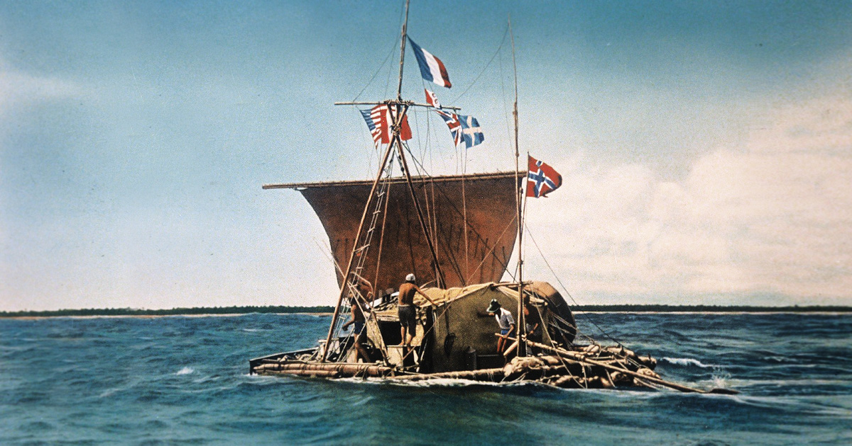
Kon Tiki

Slide 5
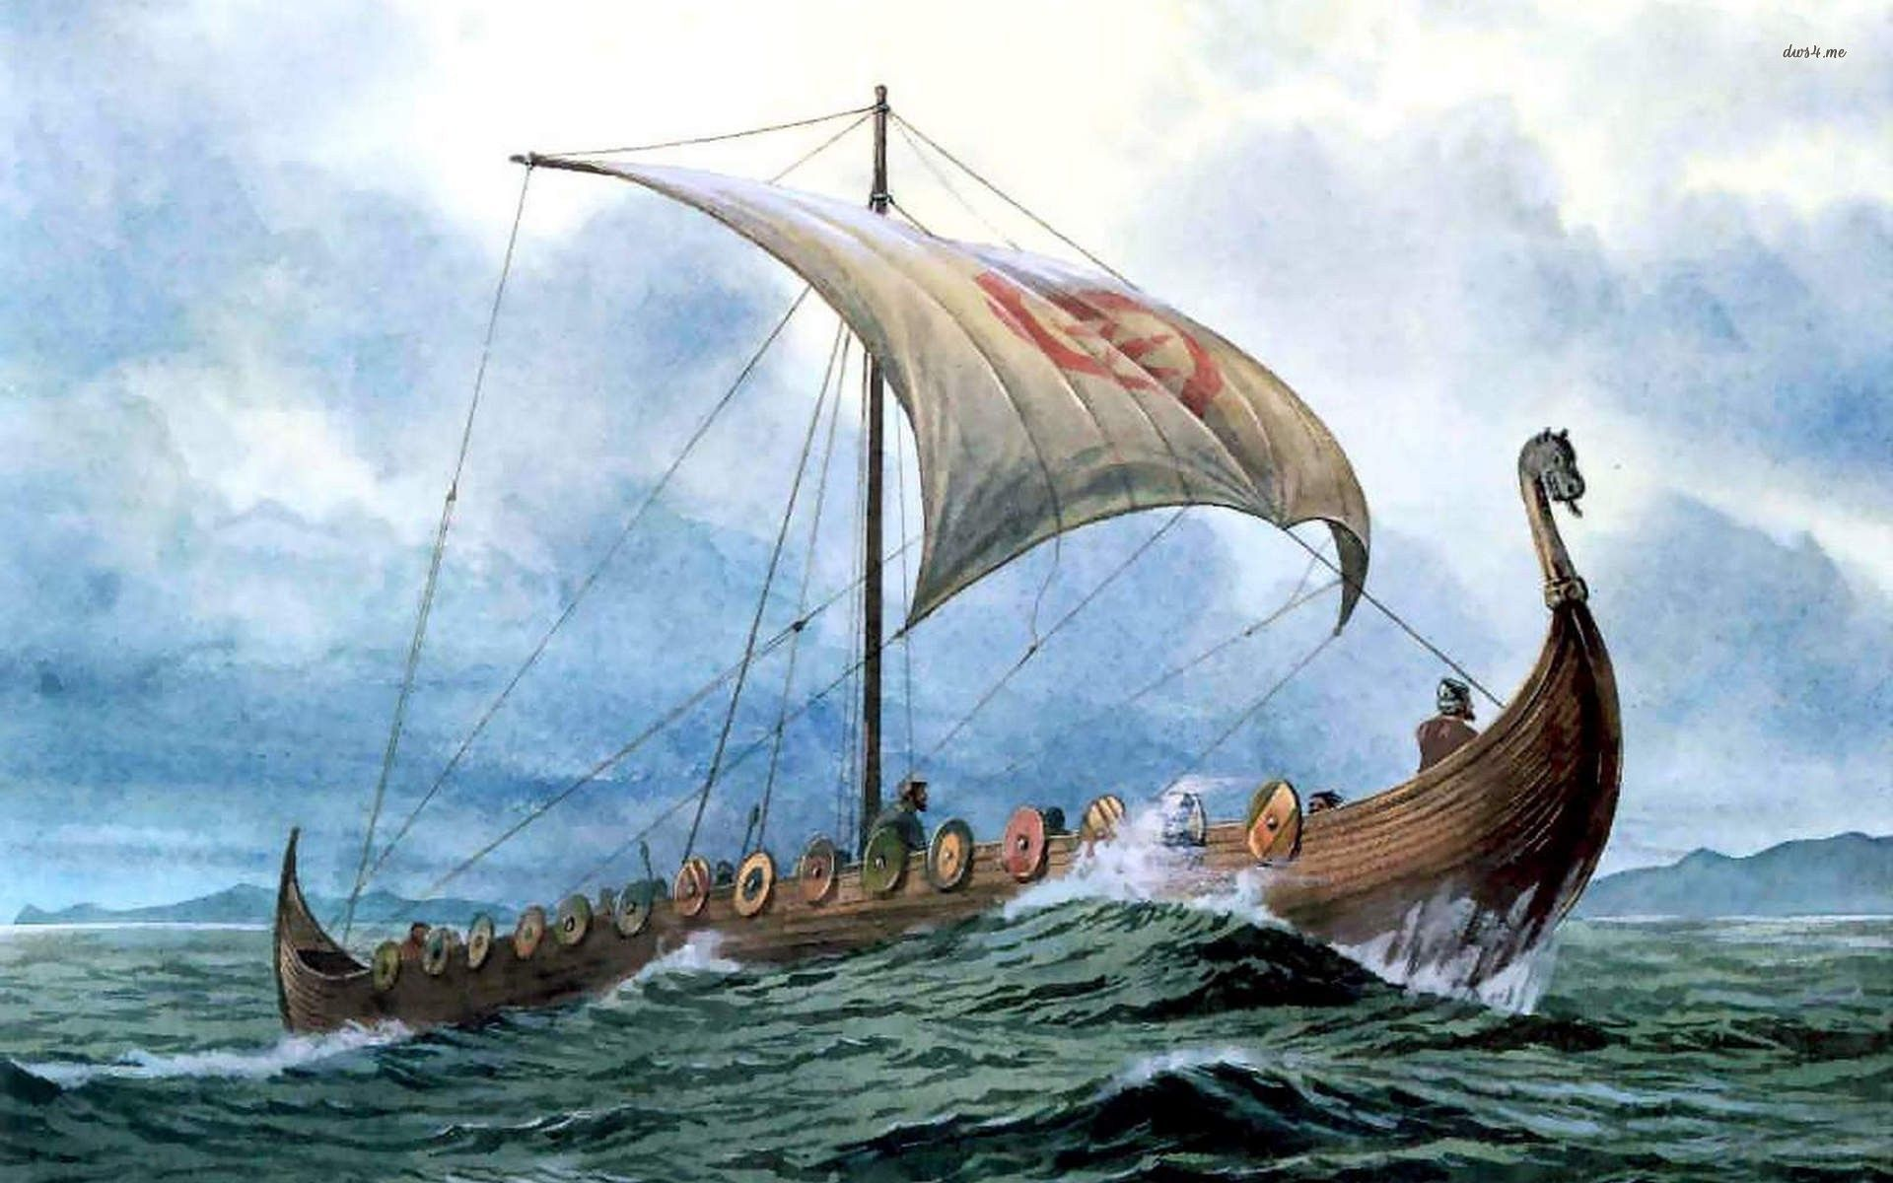
Viking Raiders Discovered North America
Vikings were bands of Scandinavian adventurers and treasure seekers who had remarkably fast, strong, and stable ships.
By 1000 A.D., the Norwegians had colonized part of North America (probably the northeastern tip of Newfoundland).
Although the colonists initially tried to cooperate with the locals, when battles ensued, they lacked the resources to make the colony a success.

Slide 6
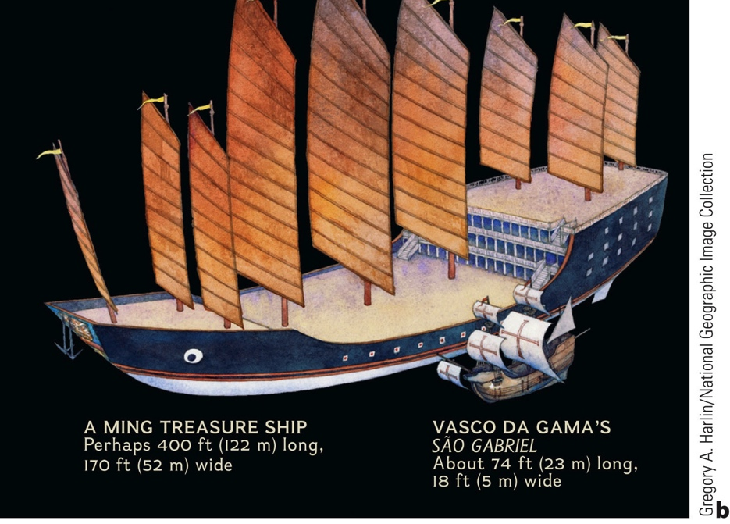
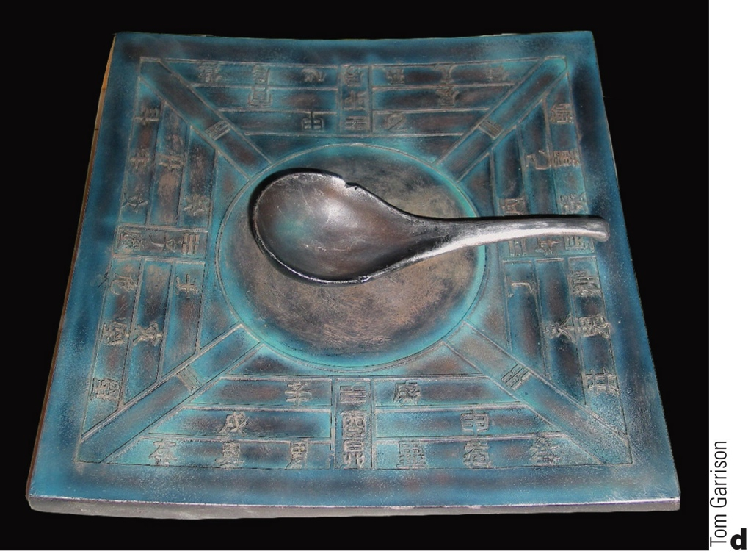
The Chinese Undertook Organized Voyages of Discovery
Chinese navigators set out in the 1400s to explore the Indian Ocean, Indonesia, Africa and the Atlantic. Their ships were laden with gifts designed to show China’s wealth and degree of civilization. The Chinese invented the compass (right), the central rudder, water-tight compartments, and sails on multiple masts.

Slide 7
Europeans explored the world by sea during the Renaissance.
Henry the Navigator – Explorers under his patronage compiled detailed charts and explored the west coast of Africa.
Christopher Columbus – Although he never saw the mainland of North America, his stories inspired other explorers to follow.
Ferdinand Magellan – Although Magellan died en route, the small surviving portion of his crew circumnavigated the globe.
European Age of Discovery

Slide 8
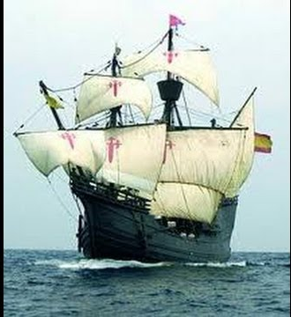
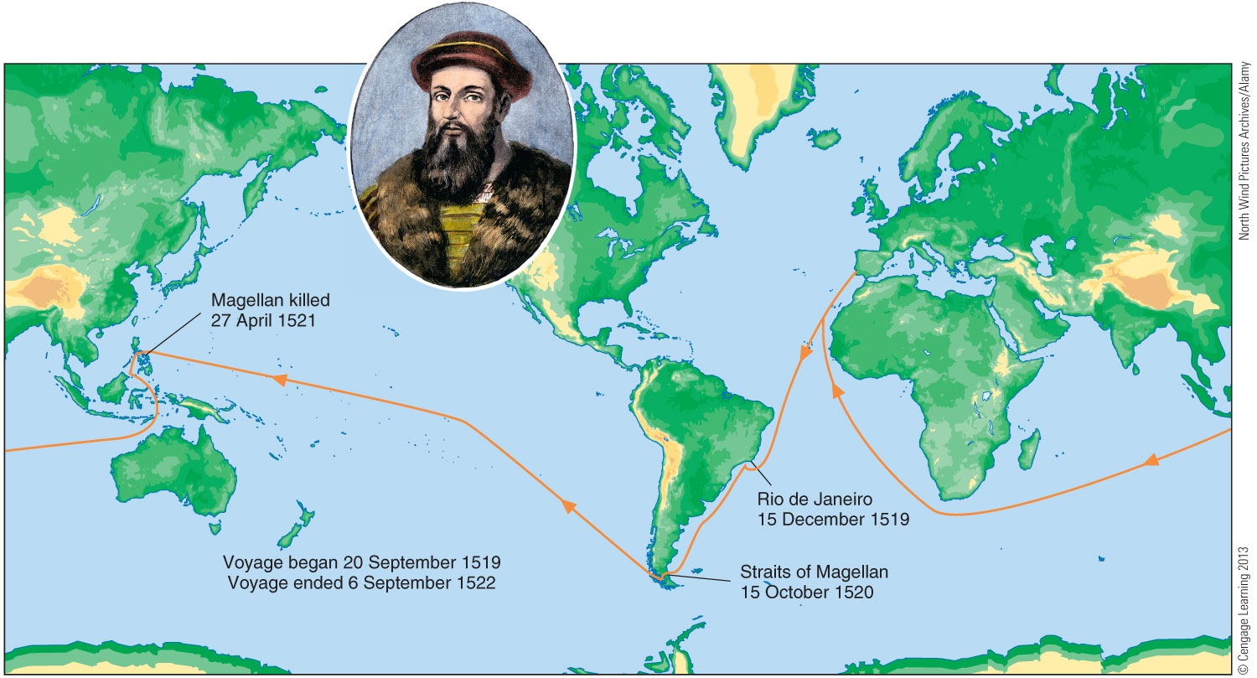
Magellan Expedition
The journey of the Magellan expedition, the first voyage around the world. Only 18 out of 260 sailors managed to return after three years of dangerous travel. The Vittoria was practically a wreck by the time she returned home to Sevilla, Spain on the 8 Sept 1522 after a voyage of 1084 days and 68,000 km. (498 years ago yesterday!)

Slide 9
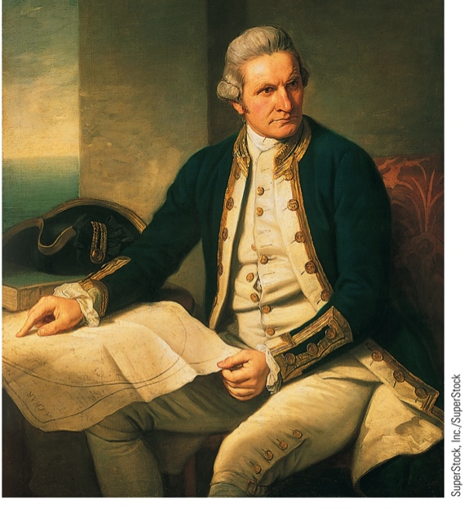
Voyaging Combined with Science to Advance Ocean Studies
James Cook, a commander in the British Royal Navy, is credited with leading three voyages that greatly contributed to scientific oceanography.
Some of the accomplishments of James Cook and his scientists include:
Verification of calculations of planetary orbits
Charting of New Zealand and the Great Barrier Reef, Tonga and Easter Island
Initiation of friendly relations with many native populations (but NOT Hawaii….)
Sampling marine life, land plants and animals
Recording data concerning the ocean floor and geological formations

Slide 10
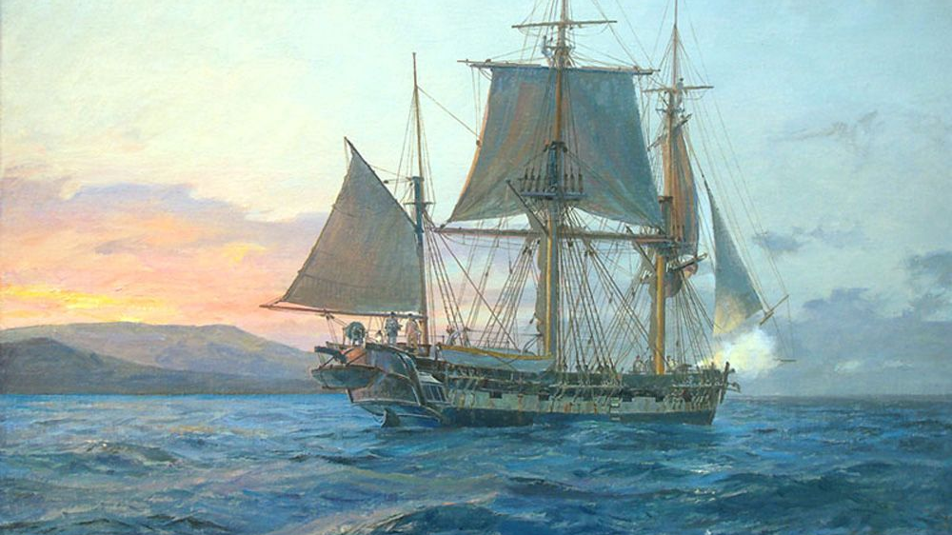
The First Scientific Expeditions Were Undertaken by Governments
The United States Exploring Expedition launched in 1838 was a naval and scientific expedition.
The HMS Beagle, on which Charles Darwin served as a naturalist, voyaged to South America and some Pacific Islands.

Slide 11
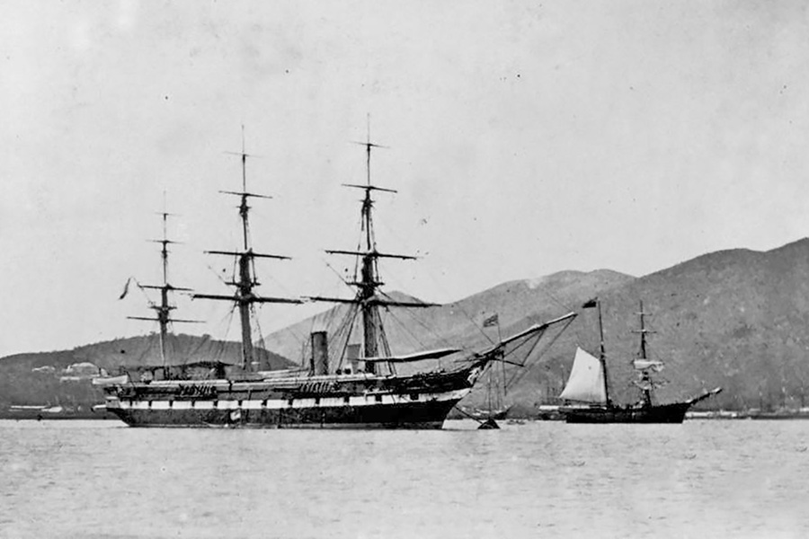
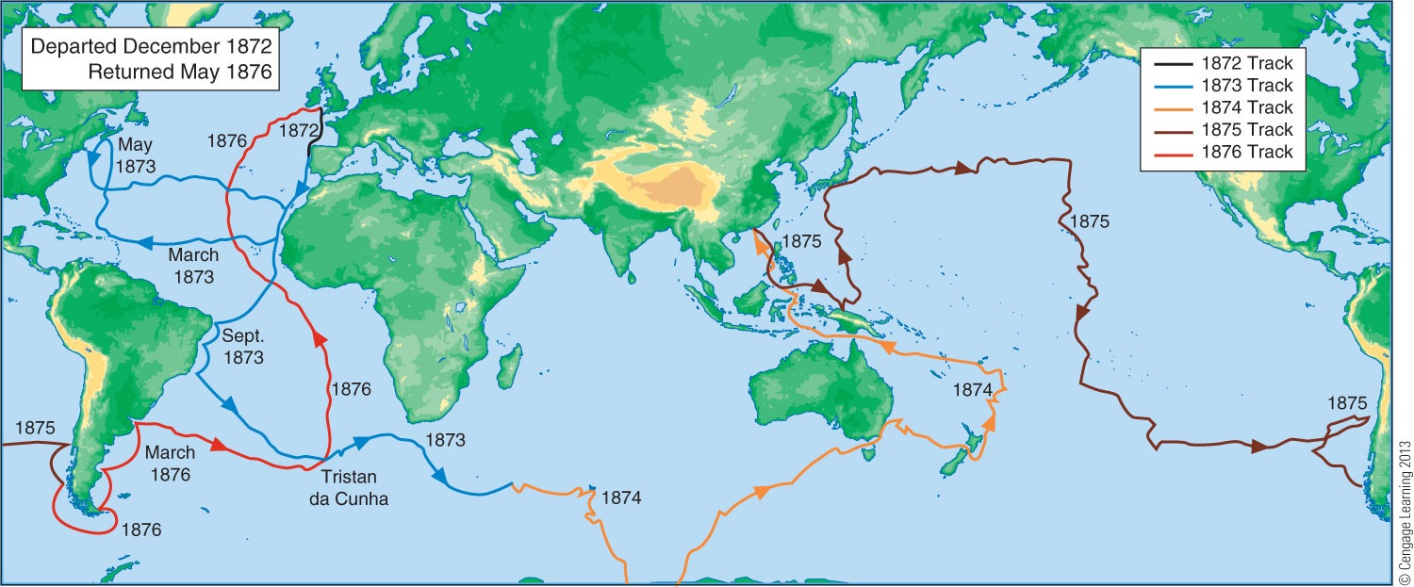
The Challenger Expedition
HMS Challenger expedition of 1872-1876 was the first oceanic expedition dedicated to scientific research.

Slide 12
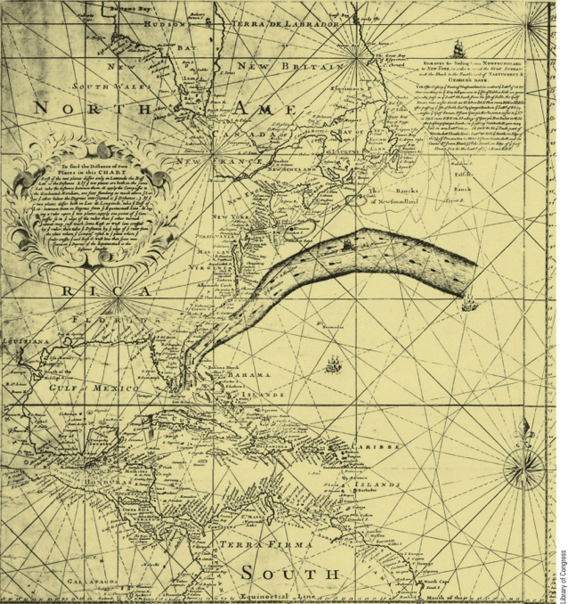
Notable Contributions to Ocean Sciences
John Harrison - Designed and built a clock that was accurate enough to determine longitude.
Ben Franklin - Noticed, and with the help of his cousin, charted and published the first chart of an ocean current, the “Gulph Stream”.
Matthew Maury - The first person to sense the worldwide pattern of surface winds and currents. Based on his analysis, he produced a set of directions for sailing great distances more efficiently.
Charles Wyville Thomson and John Murray - Proposed the Challenger Expedition which took a variety of physical oceanographic measurements, collected information on ocean currents, meteorology, the distribution of sediments, the locations and profiles of coral reefs and discovered 4,717 new species.

Slide 13
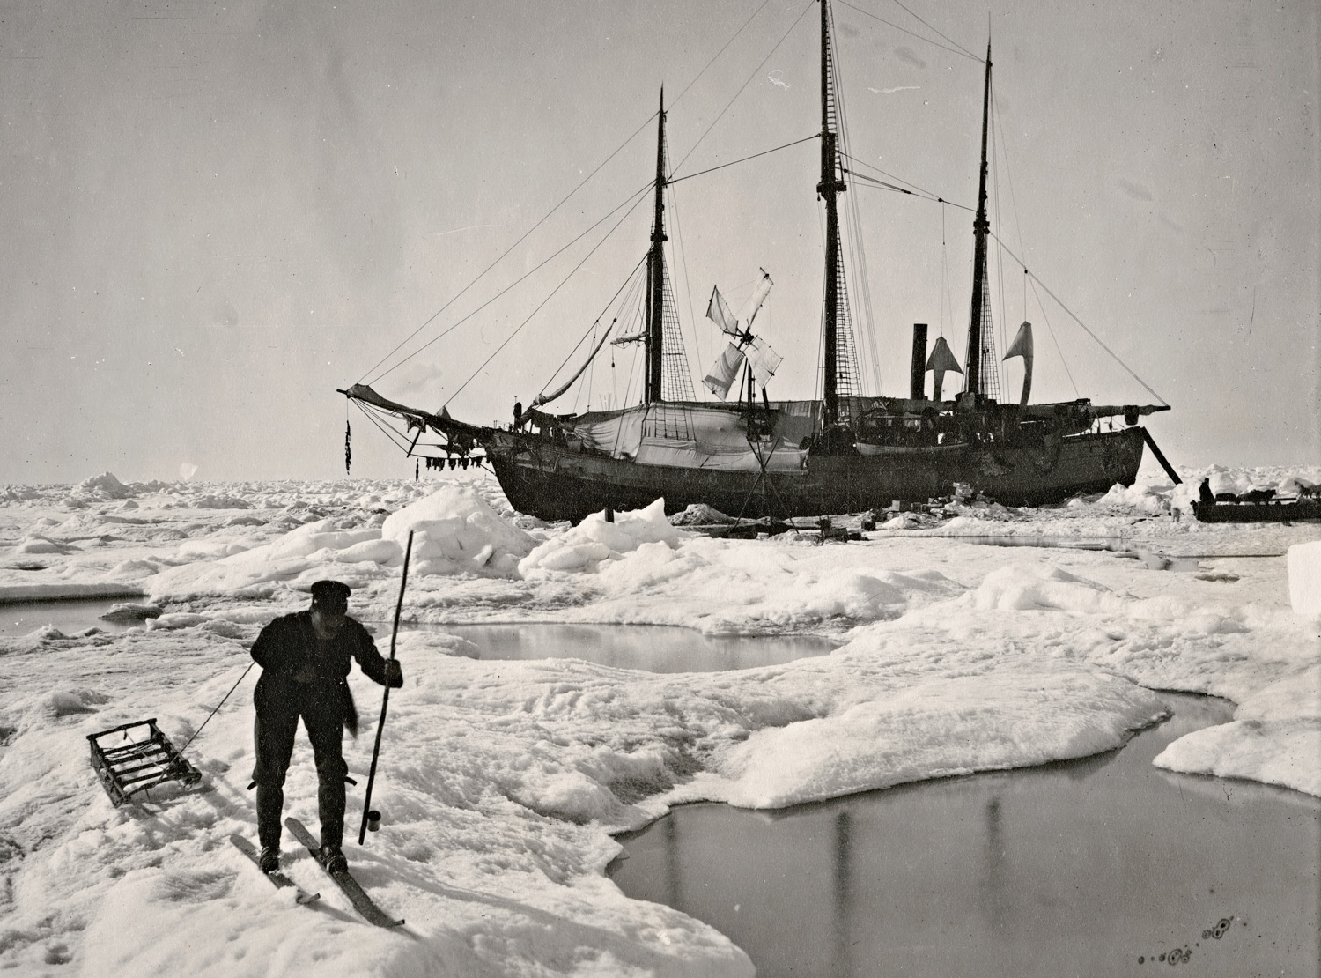
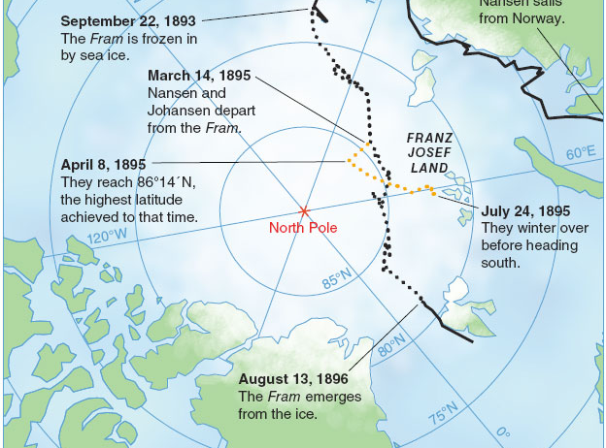
The Fram
Nansen designed a ship that would not be crushed by the ice, but instead was pushed up onto the ice flow. The stuck ship then moved across the Arctic Ocean, proving that the Arctic ice was mobile and moved by the ocean currents.

Slide 14
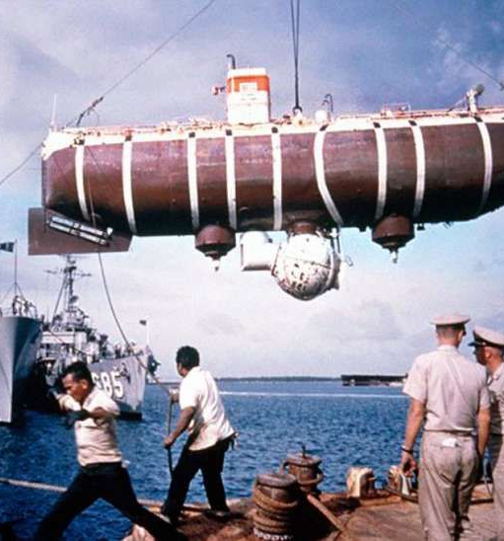
Contemporary Oceanography Makes Use of Modern Technology
Polar Exploration – explorers reached both the North and South poles in the twentieth century
The Meteor Expedition – first expedition to use modern optical and electronic equipment for oceanographic investigation
The Atlantis – investigations on this research vessel confirmed the presence of the Mid-Atlantic Ridge.
The Trieste – a blimp-like bathyscaphe which descended into the Challenger Deep area of the Mariana Trench
Glomar Challenger – samples obtained by scientists on this drilling ship provided confirming evidence for seafloor spreading and plate tectonics.

Slide 15
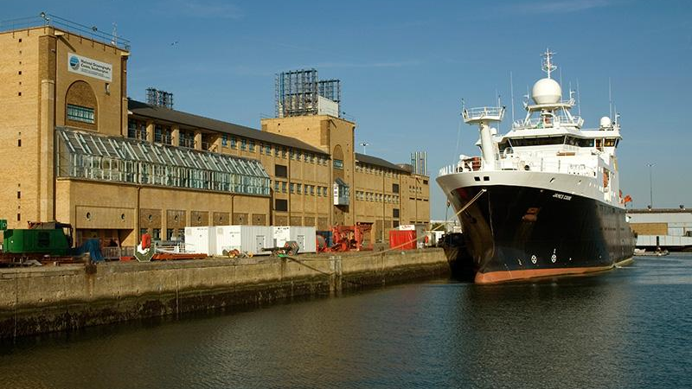
The Rise of Oceanographic Institutions
Some famous ones include:
Woods Hole Oceanographic Institution
Scripps Institution of Oceanography
National Oceanography Centre (UK)
University of Wales (Bangor)
University of Hawai’i

Slide 16
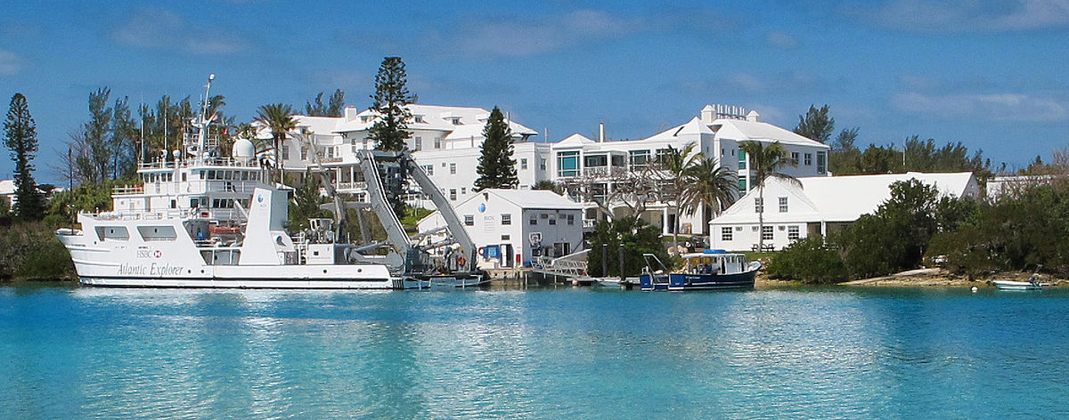
and of course, BIOS!

Slide 17
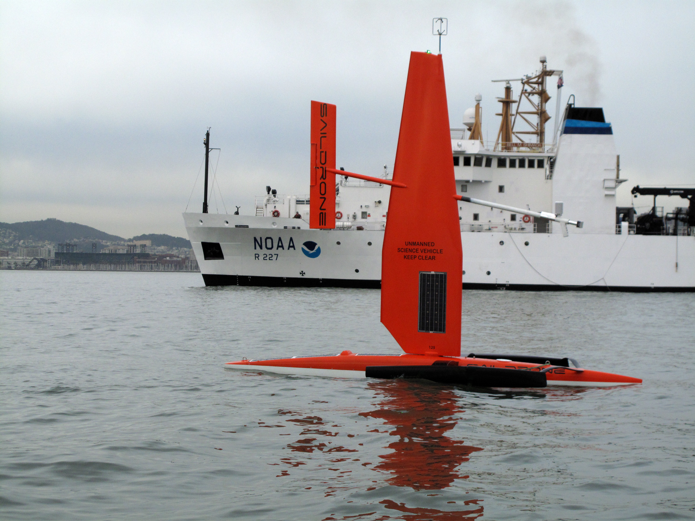
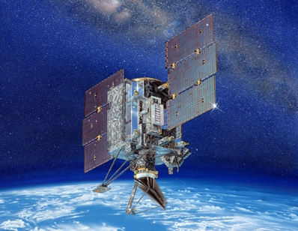
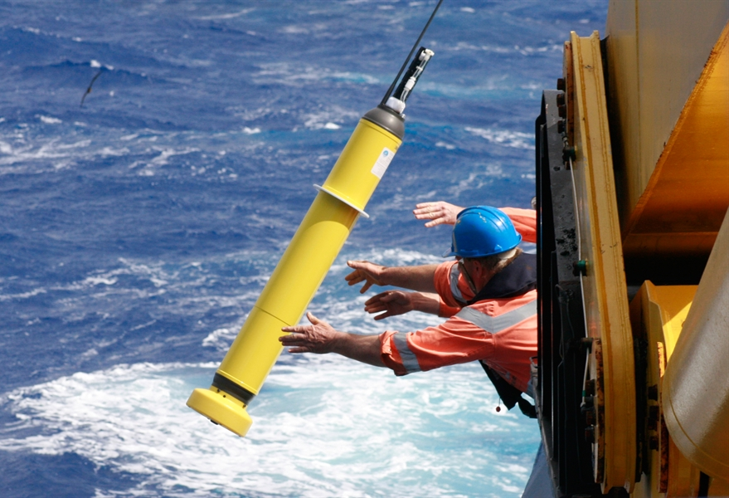
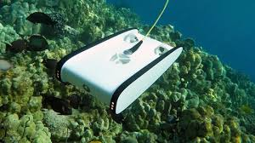
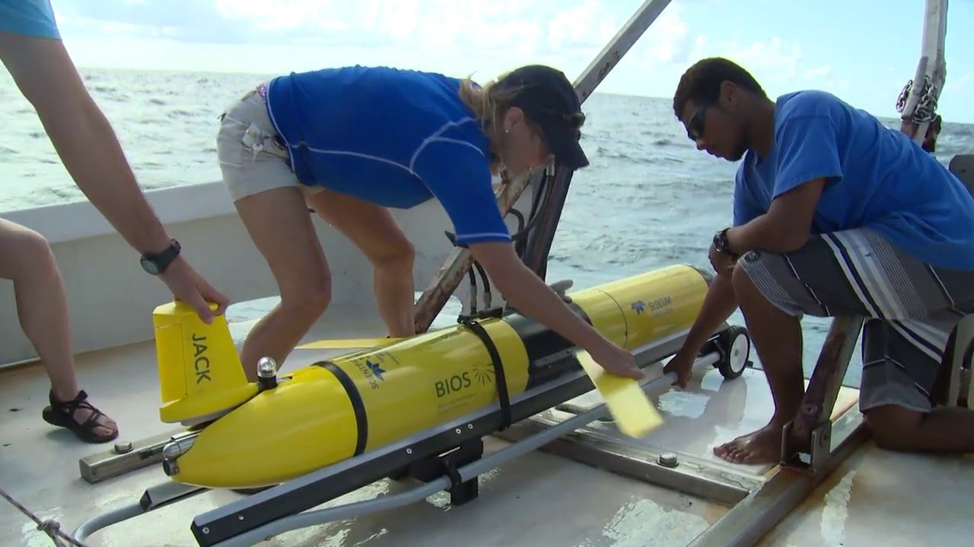
The Rise of the Robots!

